Slide 1

WELCOME TO THE
JACKSON STREET CHURCH OF CHRIST
PLEASE TURN OFF CELLPHONES

Slide 2


Slide 3


Slide 4

SINGING

Slide 5
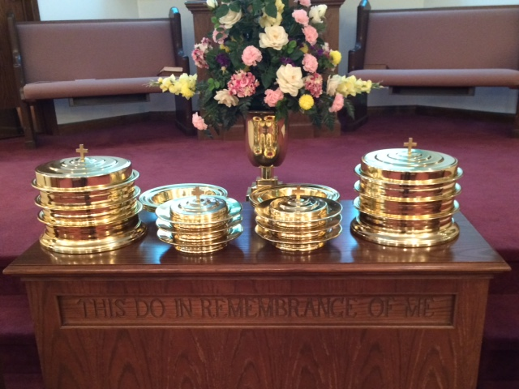
IN REMEMBRANCE OF JESUS

Slide 6
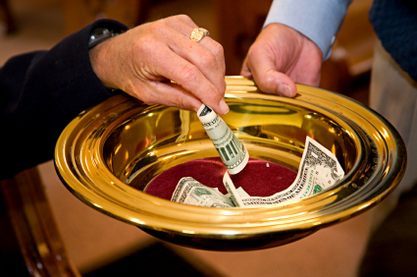
CONTRIBUTION

Slide 7
SINGING

Slide 8
(2 Tim 3:16-17) All Scripture is given by inspiration of God, and is profitable for doctrine, for reproof, for correction, for instruction in righteousness, {17} that the man of God may be complete, thoroughly equipped for every good work.

Slide 10

ALL SCRIPTURE IS INSPIRED OF GOD

Slide 11
THE BIBLE CLAIMS INSPIRATION
(John 14:25-26) "These things I have spoken to you while being present with you. {26} "But the Helper, the Holy Spirit, whom the Father will send in My name, He will teach you all things, and bring to your remembrance all things that I said to you.
(John 16:13) "However, when He, the Spirit of truth, has come, He will guide you into all truth; for He will not speak on His own authority, but whatever He hears He will speak; and He will tell you things to come.
(Mat 18:18) "Assuredly, I say to you, whatever you bind on earth will be bound in heaven, and whatever you loose on earth will be loosed in heaven.

Slide 12
THE BIBLE CLAIMS INSPIRATION
(Gal 1:11-12) But I make known to you, brethren, that the gospel which was preached by me is not according to man. {12} For I neither received it from man, nor was I taught it, but it came through the revelation of Jesus Christ.
(1 Cor 14:37) If anyone thinks himself to be a prophet or spiritual, let him acknowledge that the things which I write to you are the commandments of the Lord.
(Eph 3:3-5) how that by revelation He made known to me the mystery (as I have briefly written already, {4} by which, when you read, you may understand my knowledge in the mystery of Christ), {5} which in other ages was not made known to the sons of men, as it has now been revealed by the Spirit to His holy apostles and prophets:

Slide 13
THE BIBLE CLAIMS INSPIRATION
(2 Pet 1:21) for prophecy never came by the will of man, but holy men of God spoke as they were moved by the Holy Spirit.
(1 Th 2:13) For this reason we also thank God without ceasing, because when you received the word of God which you heard from us, you welcomed it not as the word of men, but as it is in truth, the word of God, which also effectively works in you who believe.
(1 Cor 2:13) These things we also speak, not in words which man's wisdom teaches but which the Holy Spirit teaches, comparing spiritual things with spiritual.

Slide 14
THE BIBLE CLAIMS INSPIRATION
(2 Tim 3:16-17) All Scripture is given by inspiration of God, and is profitable for doctrine, for reproof, for correction, for instruction in righteousness, {17} that the man of God may be complete, thoroughly equipped for every good work.
(2 Pet 1:3) as His divine power has given to us all things that pertain to life and godliness, through the knowledge of Him who called us by glory and virtue,
(Rev 22:18-19) For I testify to everyone who hears the words of the prophecy of this book: If anyone adds to these things, God will add to him the plagues that are written in this book; {19} and if anyone takes away from the words of the book of this prophecy, God shall take away his part from the Book of Life, from the holy city, and from the things which are written in this book.

Slide 15
The Bible is Inspired of God
How Else Can We Explain the Bible's…
Historical Accuracy Beyond Man's Power
Superhuman Scientific Foreknowledge
Superhuman Geographical Exactness
Its Indestructibility
Future Foreknowledge Beyond Man's Power
Amazing Unity Beyond Man's Power
Brute Honesty
Tremendous Influence Beyond Man's Power

Slide 16
I. Historical Accuracy Beyond Man's Power
Gen 2:10-14 Origin of civilization in Mesopotamia, Tigris-Euphrates valley
Gen 12:10 Egypt's ancient culture already highly developed
Gen 15:20 Long-lost, now archeologically-rediscovered nation of the Hittites
Gen 12:2 Ancient two thousand yr. Detailed history of the Jews
2 Kin 3:4-5 Mesha of Moab overthrows Israel as recorded on Moabite stone

Slide 17
I. Historical Accuracy Beyond Man's Power
1 Kin 14:25 Shishak's invasion of Jerusalem recorded in temple of Karnak
2 Kin 17:6 Assyrians take Samaria as recorded on Sargon II's cylinder
Gen 4:22 Instrument of iron (iron age 12th century) Iron blade found date 2700 BC
Gen 40:10-11 Grapes not thought grown in Egypt but shown in tomb paintings
Gen 6 No worldwide flood but all ancient civilizations have traditions of such

Slide 18
II. Superhuman Scientific Foreknowledge
Isa 40:22 "Circle of the earth" indicates earth's roundness
Job 26:7 Earth is hanging on nothing (not on Atlas, Turtle, etc.)
Job 26:7 Empty space in the north
Gen 17:12 Eighth day circumcision now proved height of clotting
Lev 13 Germ theory as in quarantine of lepers of Israel
Psa 8:8 The paths of the sea
Jer 31:36ff Heavens can't be measured

Slide 19
II. Superhuman Scientific Foreknowledge
Jer 33:22 Stars can't be counted (1924 - 100 billion suns in our galaxy - at 200 per minute it would take 1000 years to count them all)
Isa 51:6 Earth grow old like a garment (2nd law of thermodynamics - entropy)
Job 28:25 air has weight
1 Cor 15:39 All flesh not the same
Acts 17:26 Man of one blood
Lev 17:11 Life is in the blood
Job 38:16 Springs in the ocean
Eccl 1:7 Water cycle
Gen 3:15 Woman - seed of life

Slide 20
III. Superhuman Geographical Exactness
Acts 14:12 Names of patron gods of Lystra found on city gate in 1909
Acts 27 elaborate nautical and weather language of shipwreck voyage
Countless cities, water, mountains, still observable

Slide 21
IV. Its Indestructibility
(Mat 24:35) "Heaven and earth will pass away, but My words will by no means pass away.
(1 Pet 1:25) But the word of the LORD endures forever." Now this is the word which by the gospel was preached to you.
No book has been criticized, attacked, ridiculed, condemned, and destroyed as much as the Bible and yet it is still the most popular book ever printed. It has been translated into over 1,000 languages & dialects.

Slide 22
V. Future Foreknowledge Beyond Man's Power
Isa 13:19-22 Permanent destruction of Babylon, Arab never pitch tent there
Dan 2 Successive world kingdoms predicted: Babylon, Medo-Persia, Greece, Rome
Micah 5:2 Jesus' Bethlehem birth foretold by centuries
Isa 53:9 Jesus with wicked (thieves) and with rich (Joseph of Arimathea) in his death.

Slide 23
VI. Amazing Unity Beyond Man's Power
Eph 4:3 Unity of the Spirit
Bible written by 40 men over 1600 years describing abstractions, intangibles like soul. Love, hereafter (hardest matters to accurately describe) yet no contradiction
2 Pet 1:20 No scripture of private interpretation

Slide 24
VII. Brute Honesty
Faults revealed in heroes (David, Peter, Paul), not common in other writings of the time
Condemns the best loved sins of pagan world of that day
Goes against "human nature" and sets a higher standard of purity, love, and mercy

Slide 25
VIII. Tremendous Influence Beyond Man's Power
Only satisfactory answers for deepest problems of ages and profoundest needs of man
The Bible has shaped the course of Western Civilization
American principles derived from worth of individual (soul), must work to eat: free enterprise system (2 Thes 3:10, etc.)
Countless common words like "talent" (originally a weight of gold but came to mean "ability" by Jesus' parable)
Wherever Bible has gone, freedom, elevation of women, value of life, and ennobling of mankind has followed

Slide 26
THE BIBLE IS INSPIRED OF GOD
I. Historical Accuracy Beyond Man's Power
II. Superhuman Scientific Foreknowledge
III. Superhuman Geographical Exactness
IV. Its Indestructibility
V. Future Foreknowledge Beyond Man's Power
VI. Amazing Unity Beyond Man's Power
VII. Brute Honesty
VIII. Amazing Influence Beyond Man's Power

Slide 27
The Bible's uncanny accuracy in verifiable areas like those above, causes us to trust its dependability in uncheckable matters like man's soul, heaven, hell, etc.

Slide 28
SINGING

Slide 29
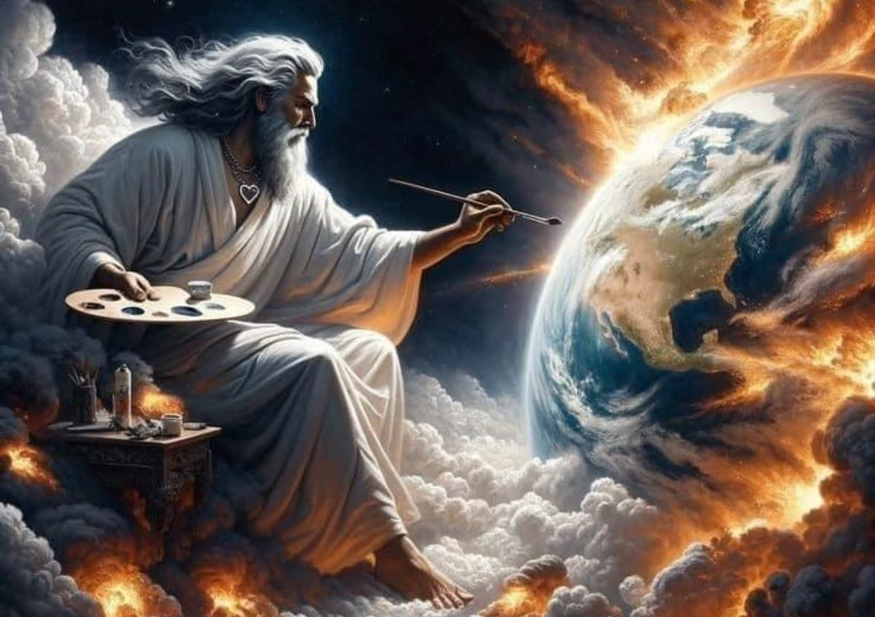
TONIGHT’S SERMON: OUR HOLY GOD

