Slide 1

WELCOME TO THE
JACKSON STREET CHURCH OF CHRIST
PLEASE TURN OFF CELLPHONES

Slide 2


Slide 3


Slide 4

SINGING

Slide 5
(Mat 16:13-19) When Jesus came into the region of Caesarea Philippi, He asked His disciples, saying, "Who do men say that I, the Son of Man, am?" {14} So they said, "Some say John the Baptist, some Elijah, and others Jeremiah or one of the prophets." {15} He said to them, "But who do you say that I am?" {16} Simon Peter answered and said, "You are the Christ, the Son of the living God." {17} Jesus answered and said to him, "Blessed are you, Simon Bar-Jonah, for flesh and blood has not revealed this to you, but My Father who is in heaven. {18} "And I also say to you that you are Peter, and on this rock I will build My church, and the gates of Hades shall not prevail against it. {19} "And I will give you the keys of the kingdom of heaven, and whatever you bind on earth will be bound in heaven, and whatever you loose on earth will be loosed in heaven."

Slide 7

THE UNFINISHED RESTORATION

Slide 8
THE RESTORATION MOVEMENT
In the early 1800s there arose men on American soil who called for a restoration of the Lord’s church of the first century.
Theirs was the desire to renew the church as God had given it.
It was a distinctive plea based on the truth that the church as built by Jesus was perfect, intended for all men of all the ages until He would come again to redeem His own.
Just as God has bestowed on man a perfect Savior and a perfect plan of redemption, so they believed the church as given by God was perfect.

Slide 9
THE RESTORATION MOVEMENT
There is no need for a new Savior. Then why are there so many new churches with differing creeds, differing organizations, and differing purposes?
In Christ are all the treasures of time and eternity, and He bestowed upon man in the beginning of the church all that was needed.
The restoration movement of America was not composed of founders or establishers. Barton Stone, Thomas and Alexander Campbell, Walter Scott, Raccoon John Smith, John O’Kelly, and other able men who labored in the restoration in its early years were not men who sought to bring a new denomination to the world.

Slide 10
THE RESTORATION MOVEMENT
Their exciting theme was “Let the Bible Speak!” and “Where the Bible speaks we speak, and where the Bible is silent, we are silent.”
To be just Christians, simply Christians, only Christians, was their great goal.
Today, some 200 years later we are the heirs of this movement, seeking the same things, having the same goals.

Slide 11
I. RESTORATION NEEDED
It is sad but true that restoration is needed in every generation.
Unknowingly and swiftly, men drift from the Lord’s teaching.
Jesus warned that there would arise false prophets (Matthew 7:15-23).
To the elders of the church at Ephesus in his final sermon to them, Paul warned of those from among themselves who would arise speaking false things to lead away the disciples (Acts 20:29-31).

Slide 12
I. RESTORATION NEEDED
Unknowingly and swiftly, men drift from the Lord’s teaching.
The great falling away would come, Paul told Timothy, and in this he alerted him to several outstanding doctrines that would characterize it, such as forbidding to marry and commanding to abstain from meats (1 Timothy 4:1-5).
Paul also pictured a general apostasy in 2 Thessalonians 2:1-12, where the Man of Sin would prevail for a time, leading away the Lord’s people through deceit and lying wonders.

Slide 13
II. THE RESTORATION IDEAL
The restoration ideal must be kept alive in every generation.
Just as every generation and every Christian, for that matter, is faced with the prospect of drifting away from the Lord’s teaching, so we need the plea to bring us back to the Lord’s complete will.
We must do what the Bible says, and that alone.
Does this generation know? Do our children understand?
Seeking to go back to the New Testament way is not nostalgia or worship of the past, but simply seeking the perfection God gave in the beginning.

Slide 14
II. THE RESTORATION IDEAL
Anytime there is a power failure, there must be a return to the source, whether it be in electricity or the matter of the soul.
Here in the restoration movement we seek perfection, the desire to be God’s people only, walk only in His ways, and have no authority except the Bible.
Non-denominational Christianity is the only hope for unity, and consequently, for the salvation of the world.

Slide 15
III. THINGS ALREADY RESTORED
Thank God there are those in our world who have led us back to the perfection, power, and beauty of the New Testament way.
The Word as living and complete authority has been restored (Revelation 22:18, 19).
The divine organization has been clearly defined.
True worship is now ours, both in spirit and in truth (John 4:24).
The divine plan of salvation, the way the Lord has ordained for us to come to Him has been placed before us in all its simplicity and beauty (John 3:16; Mark 16:15, 16).
It is now our great honor and responsibility to hand that restoration heritage to our children.

Slide 16
IV. THE UNFINISHED RESTORATION
A. First, We Must Restore The Joys Of Christian Living.
Daily life for Christians in the early church was an adventure.
Membership in the church was not an end in itself, but an experience to be lived and shared.
Joy abounded, and worship was a time of great happiness.
Yet, the predicament today is that the deep moving faith of the first century has become a habit.
Someone has said, “We are playing church. For our grandfathers it was an experience. For our fathers it became a tradition. And now for us it has become an inconvenience.”
The essence of Christianity is joy and love, and how we need to restore those to our lives today!

Slide 17
IV. THE UNFINISHED RESTORATION
A. First, We Must Restore The Joys Of Christian Living.
(Mat 13:44) "Again, the kingdom of heaven is like treasure hidden in a field, which a man found and hid; and for joy over it he goes and sells all that he has and buys that field.
(Gal 5:22-25) But the fruit of the Spirit is love, joy, peace, longsuffering, kindness, goodness, faithfulness, {23} gentleness, self-control. Against such there is no law. {24} And those who are Christ's have crucified the flesh with its passions and desires. {25} If we live in the Spirit, let us also walk in the Spirit.
(1 John 1:4) And these things we write to you that your joy may be full.

Slide 18
IV. THE UNFINISHED RESTORATION
B. Second, We Must Restore The Fervency Of Believing Prayer.
The early church was a praying church (1 Thes 5:17).
The first Christians caught the spirit of prayer because they prayed everywhere, in the temple, and at home, and wherever and whenever they came together.
The church went forward on its knees. Let us restore the power of believing prayer to our people today!

Slide 19
IV. THE UNFINISHED RESTORATION
B. Second, We Must Restore The Fervency Of Believing Prayer.
(1 Tim 2:8) I desire therefore that the men pray everywhere, lifting up holy hands, without wrath and doubting;
(Mat 21:22) "And whatever things you ask in prayer, believing, you will receive."
(Rom 12:10-12) Be kindly affectionate to one another with brotherly love, in honor giving preference to one another; {11} not lagging in diligence, fervent in spirit, serving the Lord; {12} rejoicing in hope, patient in tribulation, continuing steadfastly in prayer;

Slide 20
IV. THE UNFINISHED RESTORATION
C. Third, We Must Restore The Urgency Of Personal Soul winning.
Having neither money, influence, power, or communications as we, the early church took the gospel to the world.
The business man looked upon his work as opportunity to preach the Word, and the housewife regarded her life as one of single aim.
The church was a soul-winning institution charged with the salvation of a world lost and wandering in darkness.
Bible teaching was done everywhere.

Slide 21
IV. THE UNFINISHED RESTORATION
C. Third, We Must Restore The Urgency Of Personal Soul winning.
It was the prime responsibility of every Christian, not merely a paid staff, to seek and save the lost.
(Acts 8:4) Therefore those who were scattered went everywhere preaching the word.
(2 Tim 2:1-2) You therefore, my son, be strong in the grace that is in Christ Jesus. {2} And the things that you have heard from me among many witnesses, commit these to faithful men who will be able to teach others also.

Slide 22
IV. THE UNFINISHED RESTORATION
C. Third, We Must Restore The Urgency Of Personal Soul winning.
(Phil 2:14-16) Do all things without complaining and disputing, {15} that you may become blameless and harmless, children of God without fault in the midst of a crooked and perverse generation, among whom you shine as lights in the world, {16} holding fast the word of life, so that I may rejoice in the day of Christ that I have not run in vain or labored in vain.

Slide 23
IV. THE UNFINISHED RESTORATION
C. Third, We Must Restore The Urgency Of Personal Soul winning.
Today, can we say we have restored personal soulwinning?
Can we say we have restored this vital area when the great majority of our people live their lives and do not exert themselves to positively seek out and bring another one to Christ?
When the great majority of Christians today will not leave the comfort of their homes to call on a lost world in visitation once a week, or even once a month, can we say we have restored the church of the first century?
Here is an area of restoration that must be heavily emphasized if we are to be His church!

Slide 24
IV. THE UNFINISHED RESTORATION
D. Finally, Have We Restored The Spirit Of Sacrifice?
Those first believers looked upon their entire lives as a living sacrifice to Jesus (Romans 12:1, 2).
In Jerusalem they sold their lands, houses, goods, and possessions. (Acts 4:32-37)
The brethren of Macedonia gave out of deep poverty. (2 Cor 8:1-5)
They left their homes and went everywhere preaching the Word (Acts 8:1-8).
They sold that they might give while many, today, keep and will not give.
A few years ago we were high up on the list of per capita giving in the U.S., but now we are so low that we are not even listed among the best givers.

Slide 25
IV. THE UNFINISHED RESTORATION
D. Finally, Have We Restored The Spirit Of Sacrifice?
We spend more on gadgets and luxuries than we ever think about giving to the Lord.
Our house payment is far more than what we give for the eternal home.
(2 Sam 24:24) Then the king said to Araunah, "No, but I will surely buy it from you for a price; nor will I offer burnt offerings to the LORD my God with that which costs me nothing." So David bought the threshing floor and the oxen for fifty shekels of silver.
(Heb 13:15-16) Therefore by Him let us continually offer the sacrifice of praise to God, that is, the fruit of our lips, giving thanks to His name. {16} But do not forget to do good and to share, for with such sacrifices God is well pleased.

Slide 26
IV. THE UNFINISHED RESTORATION
D. Finally, Have We Restored The Spirit Of Sacrifice?
(2 Cor 9:6-11) But this I say: He who sows sparingly will also reap sparingly, and he who sows bountifully will also reap bountifully. {7} So let each one give as he purposes in his heart, not grudgingly or of necessity; for God loves a cheerful giver. {8} And God is able to make all grace abound toward you, that you, always having all sufficiency in all things, may have an abundance for every good work. {9} As it is written: "He has dispersed abroad, He has given to the poor; His righteousness endures forever." {10} Now may He who supplies seed to the sower, and bread for food, supply and multiply the seed you have sown and increase the fruits of your righteousness, {11} while you are enriched in everything for all liberality, which causes thanksgiving through us to God.

Slide 27
CONCLUSION
There is still room for heroic restorers.
We need leaders, who will rise up and lead us out of the lethargy and selfishness of our time to a glorious service and liberality in Christ.
The restoration continues.

Slide 28
SINGING

Slide 29
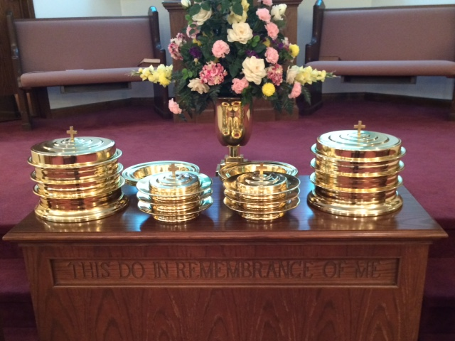
IN REMEMBRANCE OF JESUS

Slide 30
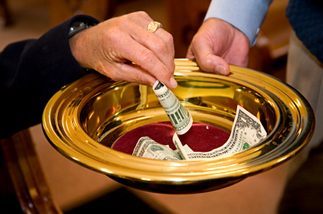
CONTRIBUTION

Slide 31
SINGING

Slide 32

TONIGHT’S SERMON: KEYS TO SELF MOTIVATION

