Slide 1
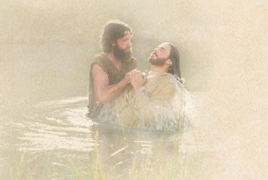
WELCOME TO THE
JACKSON STREET CHURCH OF CHRIST
PLEASE TURN OFF CELLPHONES

Slide 2


Slide 3


Slide 4

SINGING

Slide 5
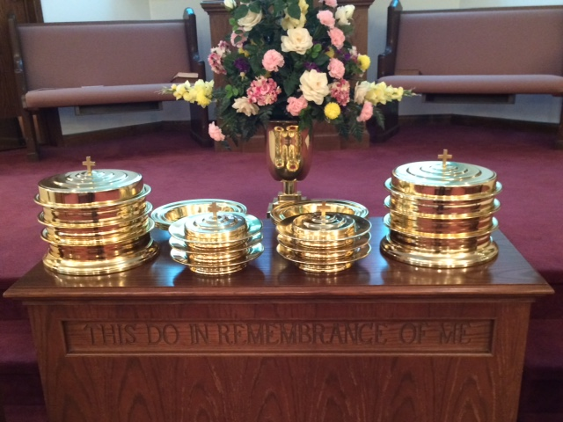
IN REMEMBRANCE OF JESUS

Slide 6
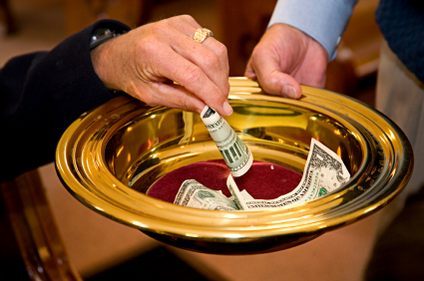
CONTRIBUTION

Slide 7
SINGING

Slide 8
Acts 16:30–34 And he brought them out and said, “Sirs, what must I do to be saved?” ³¹ So they said, “Believe on the Lord Jesus Christ, and you will be saved, you and your household.” ³² Then they spoke the word of the Lord to him and to all who were in his house. ³³ And he took them the same hour of the night and washed their stripes. And immediately he and all his family were baptized. ³⁴ Now when he had brought them into his house, he set food before them; and he rejoiced, having believed in God with all his household.

Slide 10

IS BAPTISM ESSENTIAL?

Slide 11
IS BAPTISM ESSENTIAL
Baptism is not essential to live in this world.
Baptism is not essential to be a part of many denominations.
Baptism is essential if you want what baptism offers…

Slide 12
I. BAPTISM PUTS US INTO CHRIST
Romans 6:3–6 Or do you not know that as many of us as were baptized into Christ Jesus were baptized into His death? ⁴ Therefore we were buried with Him through baptism into death, that just as Christ was raised from the dead by the glory of the Father, even so we also should walk in newness of life.⁵ For if we have been united together in the likeness of His death, certainly we also shall be in the likeness of His resurrection, ⁶ knowing this, that our old man was crucified with Him, that the body of sin might be done away with, that we should no longer be slaves of sin.

Slide 13
I. BAPTISM PUTS US INTO CHRIST
Galatians 3:26–27 For you are all sons of God through faith in Christ Jesus. ²⁷ For as many of you as were baptized into Christ have put on Christ.
1 Corinthians 12:13 For by one Spirit we were all baptized into one body—whether Jews or Greeks, whether slaves or free—and have all been made to drink into one Spirit.
All spiritual blessings are in Christ. - Ephesians 1:3 Blessed be the God and Father of our Lord Jesus Christ, who has blessed us with every spiritual blessing in the heavenly places in Christ,

Slide 14
II. BAPTISM IS FOR THE FORGIVENESS OF SINS
Acts 2:38–39 Then Peter said to them, “Repent, and let every one of you be baptized in the name of Jesus Christ for the remission of sins; and you shall receive the gift of the Holy Spirit. ³⁹ For the promise is to you and to your children, and to all who are afar off, as many as the Lord our God will call.”

Slide 15
III. BAPTISM WASHES AWAY OUR SINS
Acts 22:16 And now why are you waiting? Arise and be baptized, and wash away your sins, calling on the name of the Lord.’

Slide 16
IV. BAPTISM SAVES US
1 Peter 3:21 There is also an antitype which now saves us—baptism (not the removal of the filth of the flesh, but the answer of a good conscience toward God), through the resurrection of Jesus Christ,
Acts 2:40–41 And with many other words he testified and exhorted them, saying, “Be saved from this perverse generation.” ⁴¹ Then those who gladly received his word were baptized; and that day about three thousand souls were added to them.
Mark 16:16 He who believes and is baptized will be saved; but he who does not believe will be condemned.

Slide 17
V. BAPTISM BRINGS OUR NEW LIFE
John 3:5 Jesus answered, “Most assuredly, I say to you, unless one is born of water and the Spirit, he cannot enter the kingdom of God.
Romans 6:3–6 Or do you not know that as many of us as were baptized into Christ Jesus were baptized into His death? ⁴ Therefore we were buried with Him through baptism into death, that just as Christ was raised from the dead by the glory of the Father, even so we also should walk in newness of life. ⁵ For if we have been united together in the likeness of His death, certainly we also shall be in the likeness of His resurrection, ⁶ knowing this, that our old man was crucified with Him, that the body of sin might be done away with, that we should no longer be slaves of sin.

Slide 18
VI. BAPTISM CLOTHES US WITH CHRIST
Galatians 3:26–27 For you are all sons of God through faith in Christ Jesus. ²⁷ For as many of you as were baptized into Christ have put on Christ.

Slide 19
VII. BAPTISM RESURRECTS US FROM DEATH
Colossians 2:12 buried with Him in baptism, in which you also were raised with Him through faith in the working of God, who raised Him from the dead.
Romans 6:3–6 Or do you not know that as many of us as were baptized into Christ Jesus were baptized into His death? ⁴ Therefore we were buried with Him through baptism into death, that just as Christ was raised from the dead by the glory of the Father, even so we also should walk in newness of life. ⁵ For if we have been united together in the likeness of His death, certainly we also shall be in the likeness of His resurrection, ⁶ knowing this, that our old man was crucified with Him, that the body of sin might be done away with, that we should no longer be slaves of sin.

Slide 20
VIII. BAPTISM IS A REQUIRMENT TO ENTER HEAVEN
John 3:5 Jesus answered, “Most assuredly, I say to you, unless one is born of water and the Spirit, he cannot enter the kingdom of God.

Slide 21
BAPTISM IS ONLY ESSENTIAL FOR YOU IF YOU WANT…
To Be In Christ
To Have The Forgiveness Of Sins
To Wash Away Your Sins
To Be Saved
To Be Reborn To A New Life
To Clothe Yourself With Christ
To Be Resurrected From Death
To Enter Heaven

Slide 22
SINGING

Slide 23

TONIGHT’S SERMON: IF I TRULY LOVE MY BROTHER…

