Slide 1
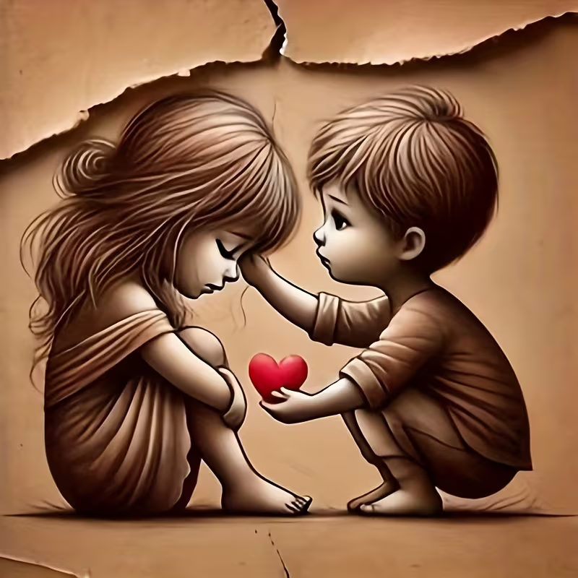
WELCOME TO THE
JACKSON STREET CHURCH OF CHRIST
PLEASE TURN OFF CELLPHONES

Slide 2


Slide 3
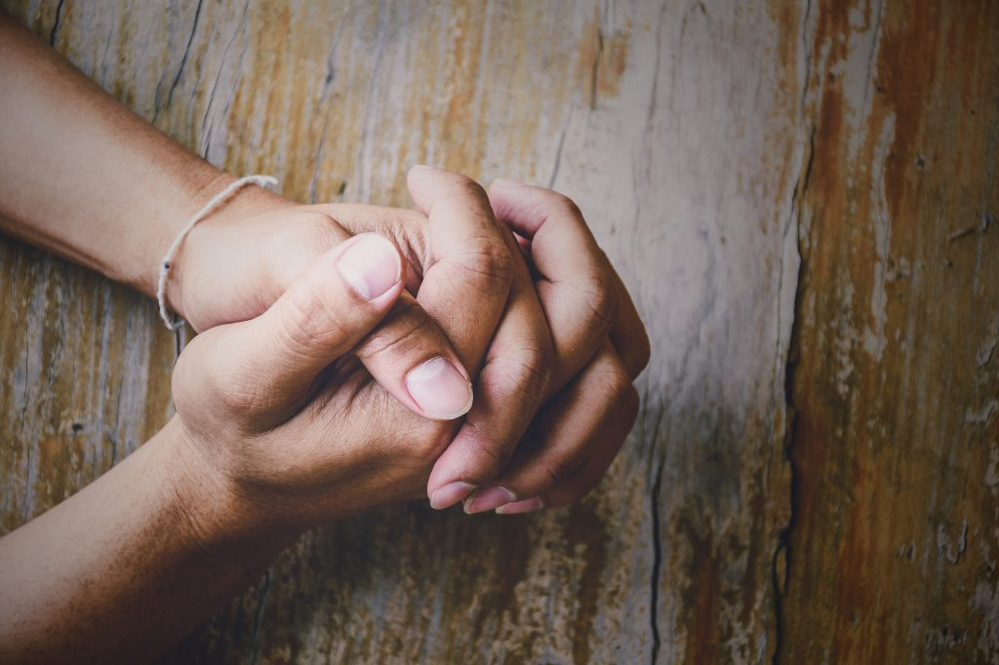
LET US PRAY

Slide 4

SINGING

Slide 5
1 John 4:20-21 If someone says, "I love God," and hates his brother, he is a liar; for he who does not love his brother whom he has seen, how can he love God whom he has not seen? 21 And this commandment we have from Him: that he who loves God must love his brother also.

Slide 6
LET US PRAY

Slide 7
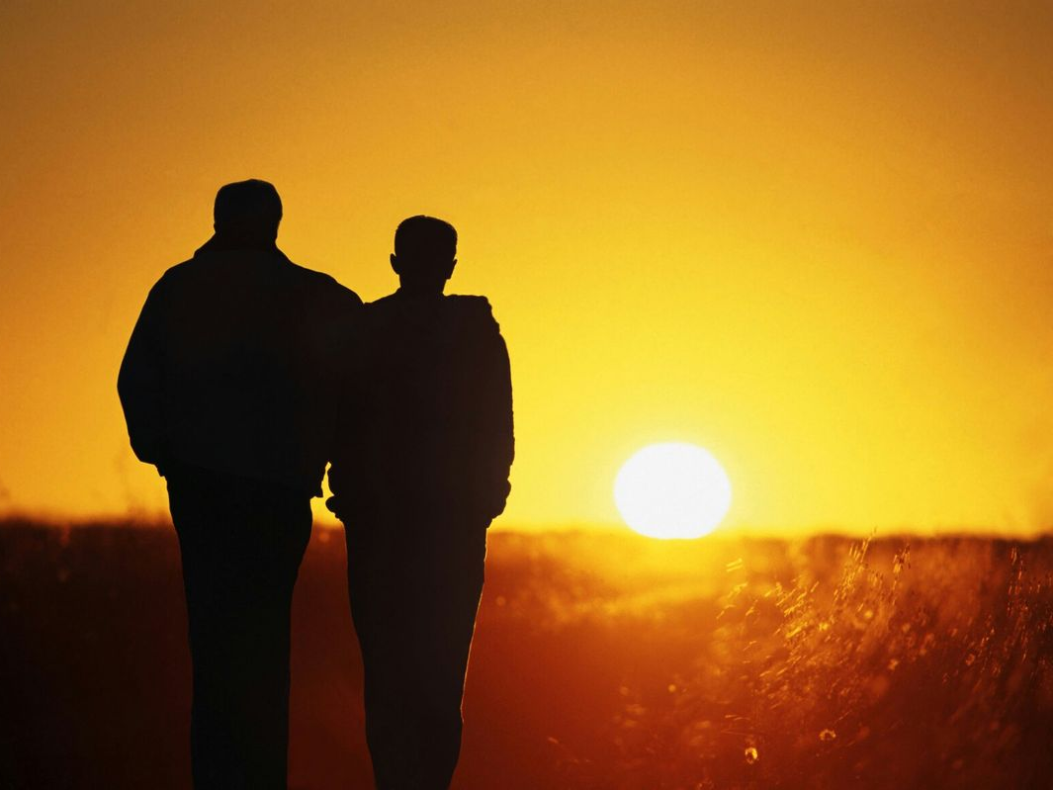
IF I TRULY LOVE MY BROTHER . . .

Slide 8
LOVE ONE ANOTHER
John 13:33-35 Little children, I shall be with you a little while longer. You will seek Me; and as I said to the Jews, 'Where I am going, you cannot come,' so now I say to you. ³⁴ A new commandment I give to you, that you love one another; as I have loved you, that you also love one another. ³⁵ By this all will know that you are My disciples, if you have love for one another."

Slide 9
LOVE ONE ANOTHER
John 15:9-17 "As the Father loved Me, I also have loved you; abide in My love. ¹⁰ If you keep My commandments, you will abide in My love, just as I have kept My Father's commandments and abide in His love. ¹¹ These things I have spoken to you, that My joy may remain in you, and that your joy may be full. ¹² This is My commandment, that you love one another as I have loved you. ¹³ Greater love has no one than this, than to lay down one's life for his friends. ¹⁴ You are My friends if you do whatever I command you. ¹⁵ No longer do I call you servants, for a servant does not know what his master is doing; but I have called you friends, for all things that I heard from My Father I have made known to you. ¹⁶ You did not choose Me, but I chose you and appointed you that you should go and bear fruit, and that your fruit should remain, that whatever you ask the Father in My name He may give you. ¹⁷ These things I command you, that you love one another.

Slide 10
LOVE ONE ANOTHER
Romans 13:8-10 Owe no one anything except to love one another, for he who loves another has fulfilled the law. ⁹ For the commandments, "You shall not commit adultery," "You shall not murder," "You shall not steal," "You shall not bear false witness," "You shall not covet," and if there is any other commandment, are all summed up in this saying, namely, "You shall love your neighbor as yourself." ¹⁰ Love does no harm to a neighbor; therefore love is the fulfillment of the law.

Slide 11
LOVE ONE ANOTHER
1 Thessalonians 3:12-13 And may the Lord make you increase and abound in love to one another and to all, just as we do to you, ¹³ so that He may establish your hearts blameless in holiness before our God and Father at the coming of our Lord Jesus Christ with all His saints.
1 Thessalonians 4:9-10 But concerning brotherly love you have no need that I should write to you, for you yourselves are taught by God to love one another; ¹⁰ and indeed you do so toward all the brethren who are in all Macedonia. But we urge you, brethren, that you increase more and more;

Slide 12
LOVE ONE ANOTHER
2 Thessalonians 1:3-4 We are bound to thank God always for you, brethren, as it is fitting, because your faith grows exceedingly, and the love of every one of you all abounds toward each other, ⁴ so that we ourselves boast of you among the churches of God for your patience and faith in all your persecutions and tribulations that you endure,
Hebrews 13:1 Let brotherly love continue.

Slide 13
LOVE ONE ANOTHER
1 Peter 1:22-23 Since you have purified your souls in obeying the truth through the Spirit in sincere love of the brethren, love one another fervently with a pure heart, ²³ having been born again, not of corruptible seed but incorruptible, through the word of God which lives and abides forever,
1 Peter 4:7-10 But the end of all things is at hand; therefore be serious and watchful in your prayers. ⁸ And above all things have fervent love for one another, for "love will cover a multitude of sins." ⁹ Be hospitable to one another without grumbling. 10 As each one has received a gift, minister it to one another, as good stewards of the manifold grace of God.

Slide 14
LOVE ONE ANOTHER
1 John 3:10-23 In this the children of God and the children of the devil are manifest: Whoever does not practice righteousness is not of God, nor is he who does not love his brother. ¹¹ For this is the message that you heard from the beginning, that we should love one another, ¹² not as Cain who was of the wicked one and murdered his brother. And why did he murder him? Because his works were evil and his brother's righteous. ¹³ Do not marvel, my brethren, if the world hates you. ¹⁴ We know that we have passed from death to life, because we love the brethren. He who does not love his brother abides in death. ¹⁵ Whoever hates his brother is a murderer, and you know that no murderer has eternal life abiding in him. ¹⁶ By this we know love, because He laid down His life for us. And we also ought to lay down our lives for the brethren. >>>

Slide 15
LOVE ONE ANOTHER
¹⁷ But whoever has this world's goods, and sees his brother in need, and shuts up his heart from him, how does the love of God abide in him? ¹⁸ My little children, let us not love in word or in tongue, but in deed and in truth. ¹⁹ And by this we know that we are of the truth, and shall assure our hearts before Him. ²⁰ For if our heart condemns us, God is greater than our heart, and knows all things. ²¹ Beloved, if our heart does not condemn us, we have confidence toward God. ²² And whatever we ask we receive from Him, because we keep His commandments and do those things that are pleasing in His sight. ²³ And this is His commandment: that we should believe on the name of His Son Jesus Christ and love one another, as He gave us commandment.

Slide 16
LOVE ONE ANOTHER
1 John 4:7-12 Beloved, let us love one another, for love is of God; and everyone who loves is born of God and knows God. ⁸ He who does not love does not know God, for God is love. ⁹ In this the love of God was manifested toward us, that God has sent His only begotten Son into the world, that we might live through Him. ¹⁰ In this is love, not that we loved God, but that He loved us and sent His Son to be the propitiation for our sins. ¹¹ Beloved, if God so loved us, we also ought to love one another. ¹² No one has seen God at any time. If we love one another, God abides in us, and His love has been perfected in us.

Slide 17
LOVE ONE ANOTHER
2 John 1:5-6 And now I plead with you, lady, not as though I wrote a new commandment to you, but that which we have had from the beginning: that we love one another. ⁶ This is love, that we walk according to His commandments. This is the commandment, that as you have heard from the beginning, you should walk in it.

Slide 18
IF I TRULY LOVE MY BROTHER . . . IT WILL SHOW IN MY ACTIONS

Slide 19
IF I TRULY LOVE MY BROTHER . . .
I WILL PREFER HIM - Romans 12:10 Be kindly affectionate to one another with brotherly love, in honor giving preference to one another;
I WILL SHARE WITH HIM - 1 John 3:16–17 By this we know love, because He laid down His life for us. And we also ought to lay down our lives for the brethren. ¹⁷ But whoever has this world’s goods, and sees his brother in need, and shuts up his heart from him, how does the love of God abide in him?
I WILL FORGIVE HIM - Ephesians 4:32 And be kind to one another, tenderhearted, forgiving one another, even as God in Christ forgave you.

Slide 20
IF I TRULY LOVE MY BROTHER . . .
I WILL BE KIND TO HIM - Romans 12:10 Be kindly affectionate to one another with brotherly love, in honor giving preference to one another;
I WILL NOT SPEAK EVIL OF HIM - James 4:11–12 Do not speak evil of one another, brethren. He who speaks evil of a brother and judges his brother, speaks evil of the law and judges the law. But if you judge the law, you are not a doer of the law but a judge. ¹² There is one Lawgiver, who is able to save and to destroy. Who are you to judge another?
I WILL RESTORE HIM - Galatians 6:10 Therefore, as we have opportunity, let us do good to all, especially to those who are of the household of faith.

Slide 21
IF I TRULY LOVE MY BROTHER . . .
I WILL NOT OFFEND HIM - Romans 14:19–23 Therefore let us pursue the things which make for peace and the things by which one may edify another. ²⁰ Do not destroy the work of God for the sake of food. All things indeed are pure, but it is evil for the man who eats with offense. ²¹ It is good neither to eat meat nor drink wine nor do anything by which your brother stumbles or is offended or is made weak. ²² Do you have faith? Have it to yourself before God. Happy is he who does not condemn himself in what he approves. ²³ But he who doubts is condemned if he eats, because he does not eat from faith; for whatever is not from faith is sin.
I WILL HELP HIM GROW STRONGER - Hebrews 12:12–13 Therefore strengthen the hands which hang down, and the feeble knees, ¹³ and make straight paths for your feet, so that what is lame may not be dislocated, but rather be healed.

Slide 22
IF I TRULY LOVE MY BROTHER…
I WILL ENCOURAGE HIM TO GOOD WORKS - Hebrews 10:24–25 And let us consider one another in order to stir up love and good works, ²⁵ not forsaking the assembling of ourselves together, as is the manner of some, but exhorting one another, and so much the more as you see the Day approaching.
I WILL NOT BE JEALOUS OF HIM - 2 Corinthians 12:20 For I fear lest, when I come, I shall not find you such as I wish, and that I shall be found by you such as you do not wish; lest there be contentions, jealousies, outbursts of wrath, selfish ambitions, backbitings, whisperings, conceits, tumults;

Slide 23
IF YOU TRULY LOVE YOUR BROTHER?
You Will Prefer Him
You Will Share With Him
You Will Forgive Him
You Will Be Kind To Him
You Will Not Speak Evil Of Him
You Will Restore Him
You Will Not Offend Him
You Will Help Him Grow Stronger
You Will Encourage Him To Good Works
You Will Not Be Jealous Of Him

Slide 24
SINGING

Slide 25
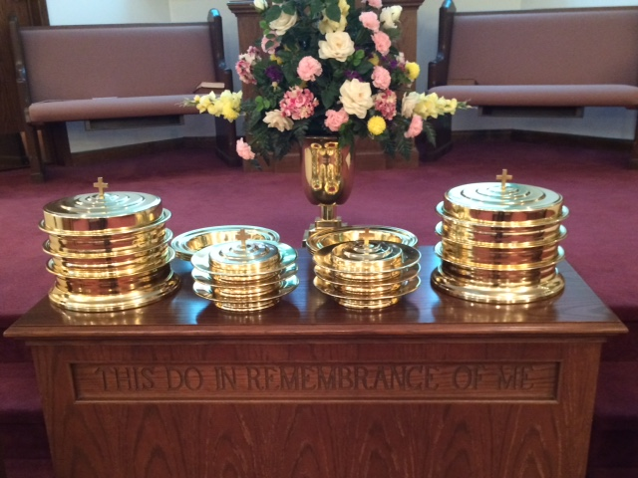
IN REMEMBRANCE OF JESUS

Slide 26
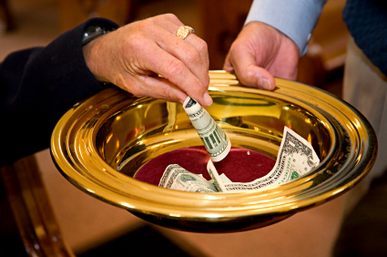
CONTRIBUTION

Slide 27
SINGING

Slide 28
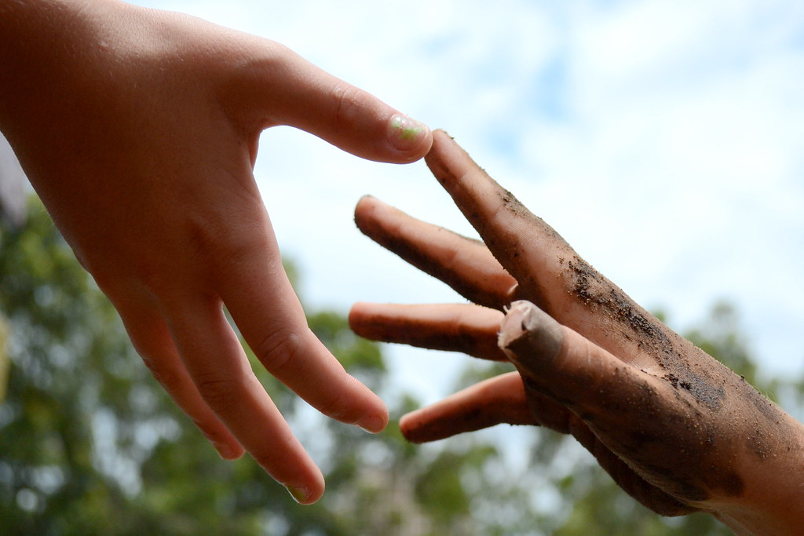
HAVE A
LOVING WEEK

