Slide 6
How To Keep
New Year’s Resolutions
Think About It

Slide 7
How To Keep
New Year’s Resolutions
Think about it
Need to be Reminded

Slide 8
How To Keep
New Year’s Resolutions
Think about it
Need to be Reminded
Need extra Help

Slide 9
How To Keep
New Year’s Resolutions
Think about it
Need to be Reminded
Need extra Help
Work at it
Ecclesiastes 9:10
“Whatever your hand finds to do,
do it with all your might”

Slide 10
What Things Need to be done well?
Colossians 3:2
Set your mind on things above,
not own things on the earth.

Slide 11
What Makes
Resolutions
So Hard?

Slide 14
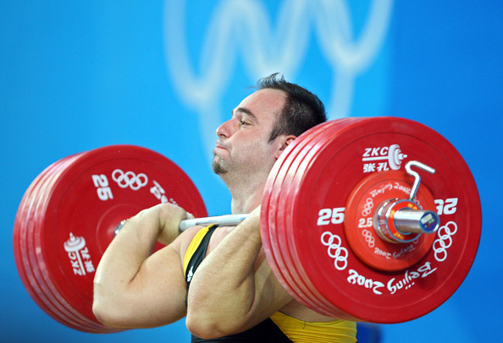

Slide 18
Better

Slide 19
Better
Spiritual
Life

Slide 20
Better Spiritual Life
1Cor.15:58
Therefore, my beloved brethren,
be steadfast, immovable, always abounding
in the work of the Lord, knowing that your
Labor is not in vain in the Lord.

Slide 21
Be a Better Christian
better at pleasing God with my life
better at walking in the light
better at doing what God would want me to do
better in daily living
better in attitude
better in attention
better in attendance

Slide 22
ARE YOU A CHRISTIAN?
Hear – Rom.10:17
Faith – Jn.8:24
Repent – Acts 17:30
Confess – Rom. 10:9
Be Baptized – 1 Pet.3:21
ARE YOU A FAITHFUL CCHRISTIAN?
Confess sins – James 5:16
Live faithfully – Matt:10:22

