Slide 2
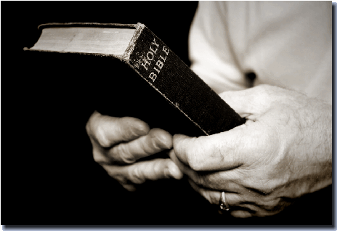
Growing
In
Grace

Slide 3
Growing
In
Grace
2 Pet. 3:17,18
¹⁷ You therefore, beloved, knowing this before-hand, take care that you are not carried away with the error of lawless people and lose your own stability. ¹⁸ But grow in the grace and knowledge of our Lord and Savior Jesus Christ. To him be the glory both now and to the day of eternity. Amen.
Notes:
2 Peter 3:17-18
You therefore, beloved, knowing this beforehand, take care that you are not carried away with the error of lawless people and lose your own stability. ¹⁸ But grow in the grace and knowledge of our Lord and Savior Jesus Christ. To him be the glory both now and to the day of eternity. Amen.

Slide 4
What is Growing
In Grace?
Grow in God’s Favor?
2 Tim. 2:1
You then, my child, be strengthened by the grace that is in Christ Jesus,
Notes:
A. What exactly did Peter mean when he said, "Grow in grace?
1. This could mean grow in God's favor –
a. Paul seems to indicate this in 2 Tim.2:1. You then, my child,
be strengthened by the grace that is in Christ Jesus,

Slide 5
What is Growing
In Grace?
Grow in God’s Worded Grace?
Titus 2:11-12
¹¹ For the grace of God has appeared, bringing salvation for all people, ¹² training us to renounce ungodliness and worldly passions, and to live self-controlled, upright, and godly lives in the present age,
Notes:
2. Or, it could mean in His worded grace –
a. Paul, in Titus 2:11,12 tells us ¹¹ For the grace of God has
appeared, bringing salvation for all people, ¹² training us to
renounce ungodliness and worldly passions, and to live self-
controlled, upright, and godly lives in the present age,

Slide 6
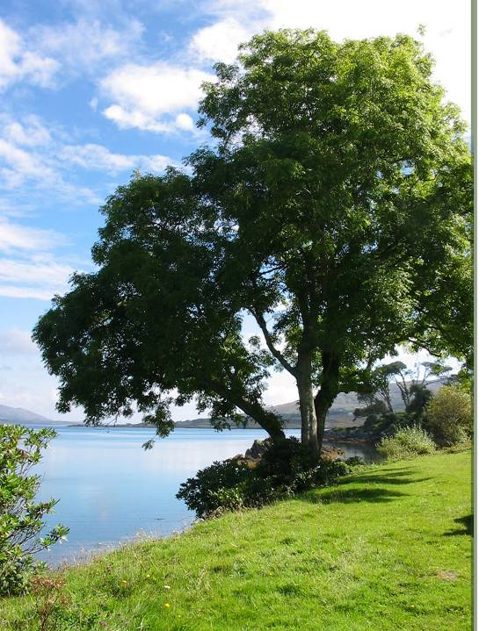
Psalms 1:3
He is like a tree planted by streams of water that yields its fruit in its season, and its leaf does not wither. In all that he does, he prospers.
Notes:
B. The righteous are compared to a tree:
1. Ps.1:1-3. Blessed is the man who walks not in the counsel of the
wicked, nor stands in the way of sinners, nor sits in the seat of
scoffers; ² but his delight is in the law of the Lord, and on his
law he meditates day and night. ³ He is like a tree planted by
streams of water that yields its fruit in its season, and its leaf
does not wither. In all that he does, he prospers.

Slide 7
Growing
In
Grace
Notes:
C. In this lesson we take a look at the Christian as he grows in the
grace of our Lord Jesus Christ.

Slide 8
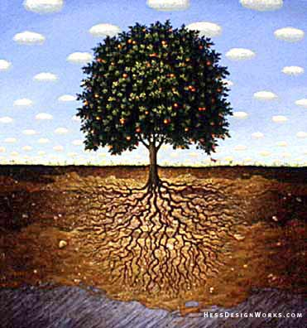
We must grow DOWNWARD
Notes:
As you can see here, this tree has roots as deep in the ground as it is tall above the ground. This is a well rooted tree.
1. As this tree is well rooted, so we are admonished to be rooted
and grounded.

Slide 9
We must grow DOWNWARD
We are admonished to be
grounded in love and faith
Eph. 3:17
so that Christ may dwell in your hearts through faith—that you, being rooted and grounded in love
Col. 2:6-7
Therefore, as you received Christ Jesus the Lord, so walk in him, rooted and built up in him and established in the faith
Notes:
2. We are to be Rooted and grounded in Love –
a. Paul tells us this in Eph.3:17. so that Christ may dwell in your
hearts through faith—that you, being rooted and grounded in
love,
3. Not only are we to be grounded in love, we are to be Rooted and
settled in Faith –
a. Again, the apostle Paul in Col.2:6-7. Therefore, as you
received Christ Jesus the Lord, so walk in him, ⁷ rooted and
built up in him and established in the faith,

Slide 10
We must grow DOWNWARD
Why?
So not tossed to and fro
Eph. 4:14-15
¹⁴ so that we may no longer be children, tossed to and fro by the waves and carried about by every wind of doctrine, by human cunning, by craftiness in deceitful schemes. ¹⁵ Rather, speaking the truth in love, we are to grow up in every way into him who is the head, into Christ
Notes:
B. Why are we to be so rooted and grounded in our faith?
1. There are several reasons
a. So as not to be tossed to and fro – Eph.4:14,15. ¹⁴ so that we
may no longer be children, tossed to and fro by the waves
and carried about by every wind of doctrine, by human
cunning, by craftiness in deceitful schemes. ¹⁵ Rather,
speaking the truth in love, we are to grow up in every way
into him who is the head, into Christ,

Slide 11
We must grow DOWNWARD
Why?
So not tossed to and fro
To make us unmovable
1 Cor. 15:58
Therefore, my beloved brethren, be steadfast, immovable, always abounding in the work of the Lord, knowing that your labor is not in vain in the Lord.
Notes:
b. This is to make us unmovable – 1 Cor.15:58. Therefore, my
beloved brethren, be steadfast, immovable, always
abounding in the work of the Lord, knowing that your labor is
not in vain in the Lord.

Slide 12
We must grow DOWNWARD
Why?
So not tossed to and fro
To make us unmovable
Those not rooted will ultimately be lost
Matt. 13:20-21
²⁰ As for what was sown on rocky ground, this is the one who hears the word and immediately receives it with joy, ²¹ yet he has no root in himself, but endures for a while, and when tribulation or persecution arises on account of the word, immediately he falls away.
Notes:
c. Those not rooted will ultimately be lost –
1) Jesus spoke of these in His parable of the sower in
Matt.13:20,21. ²⁰ As for what was sown on rocky ground,
this is the one who hears the word and immediately
receives it with joy, ²¹ yet he has no root in himself, but
endures for a while, and when tribulation or persecution
arises on account of the word, immediately he falls away.

Slide 13
We must grow DOWNWARD
How?
1 Pet. 3:15-16
but in your hearts regard Christ the Lord as holy, always being prepared to make a defense to anyone who asks you for a reason for the hope that is in you; ¹⁶ yet do it with gentleness and respect, having a good conscience
2 Tim. 2:15
Do your best to present yourself to God as one approved, a worker who has no need to be ashamed, rightly handling the word of truth.
Notes:
C. The next question is How can we grow downward? How can
we become rooted in our faith?
1. Peter tells us how in 1 Pet.3:15-16. but in your hearts regard
Christ the Lord as holy, always being prepared to make a defense
to anyone who asks you for a reason for the hope that is in you;
¹⁶ yet do it with gentleness and respect, having a good
conscience
2. We are to have depth and it can only come though study of
God's word – 2 Tim.2:15. Do your best to present yourself to
God as one approved, a worker who has no need to be ashamed,
rightly handling the word of truth.

Slide 14
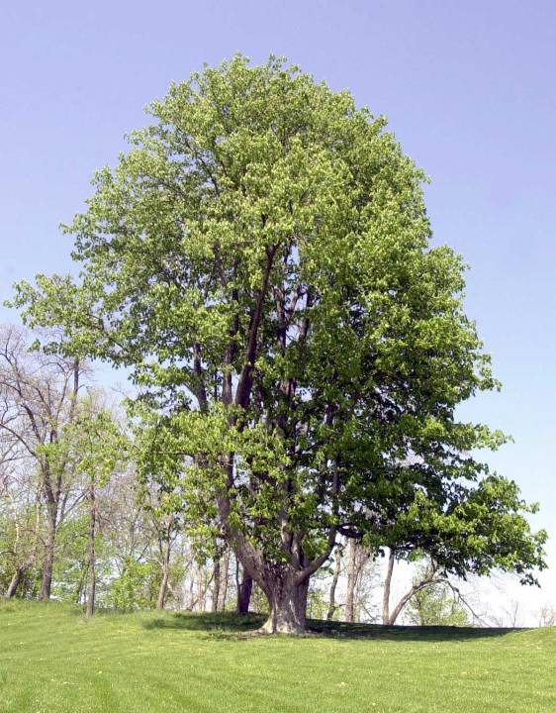
We must grow UPWARD
Notes:
II. The Christian must Grow UPWARD.
A. Here, we see a tree that has grown upward, towering above all the
other trees around.

Slide 15
We must grow UPWARD
We must have depth
Lk. 9:26
For whoever is ashamed of me and of my words, of him will the Son of Man be ashamed when he comes in his glory and the glory of the Father and of the holy angels.
Heb. 11:1
Now faith is assurance of things hoped for,
a conviction of things not seen
Notes:
1. The Christian must grow So as to have as much height as he
does depth.
2. The christian must never be ashamed to stand up for Christ.
a. Jesus tells us in Lk.9:26. For whoever is ashamed of me and
of my words, of him will the Son of Man be ashamed when
he comes in his glory and the glory of the Father and of the
holy angels.
3. We must build great confidence in our faith and our hope must
be as high as our faith is deep.
a. Heb.11:1– “Now faith is assurance of [things] hoped for, a
conviction of things not seen.”
b. Our faith and hope must be active and seen.

Slide 16
We must grow UPWARD
To grow upward we must
Focus our mind on the things above
Col. 3:2-3
Set your minds on things that are above, not on things that are on earth. ³ For you have died, and your life is hidden With Christ in God.
Notes:
B. To grow upward we must Focus our mind on the things above –
1. Paul says in Col.3:2-3. Set your minds on things that are above,
not on things that are on earth. ³ For you have died, and your
ife is hidden with Christ in God.

Slide 17
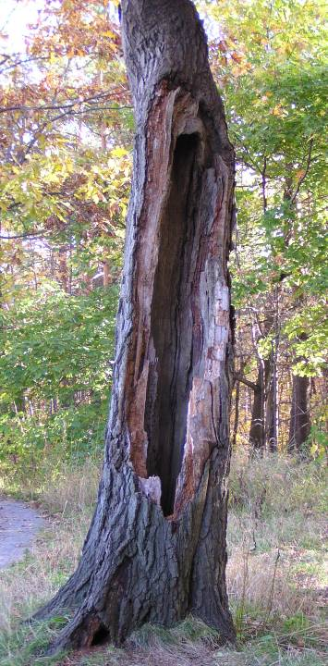
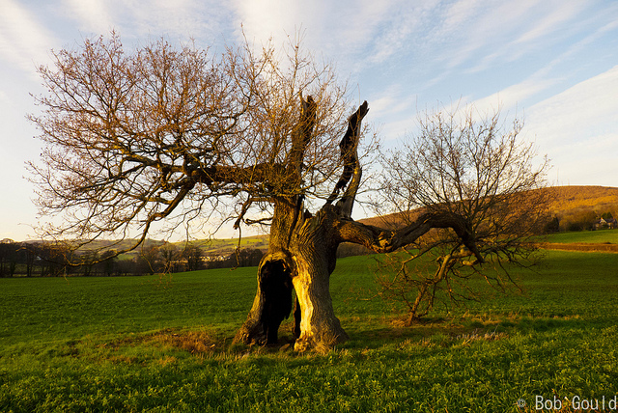
We must grow INWARD
Notes:
III. The Christian must Grow INWARD.
A. This is the backbone of the Christian, his conviction.
1. Here we have a picture of a hollow tree.
a. An Interesting thing about hollow trees
1) They're either dead, like this one -

Slide 18
We must grow INWARD
Notes:
2) Or they're dying like this one

Slide 19
We must grow INWARD
The inward man must be developed
Matt. 12:43-45
⁴³ "When the unclean spirit has gone out of a person, it passes through waterless places seeking rest, but finds none. ⁴⁴ Then it says, 'I will return to my house from which I came.' And when it comes, it finds the house empty, swept, and put in order. ⁴⁵ Then it goes and brings with it seven other spirits more evil than itself, and they enter and dwell there, and the last state of that person is worse than the first.
Notes:
B. To grow in our Christianity, we must development the
inward man.
1. In other words, it must be occupied –
2. I want you to listen to something Jesus told the scribes and
Pharisees in Matt.12:43-45. ⁴³ "When the unclean spirit has gone out of a person, it passes through waterless places seeking rest, but finds none. ⁴⁴ Then it says, 'I will return to my house from which I came.' And when it comes, it finds the house empty, swept, and put in order. ⁴⁵ Then it goes and brings with it seven other spirits more evil than itself, and they enter and dwell there, and the last state of that person is worse than the first.
a. As we rid ourselves of the evil spirit, or sin in our lives, we
must replace it with the righteous spirit the Lord wants us to
have.
b. Our spiritual lives must be strengthened – It must be
renewed every day.
c. Because if it is not and if it becomes empty, just as Jesus
said here, the last state is worse than the first.

Slide 20
We must grow INWARD
To grow inwardly requires a
good and honest heart
Lk. 8:15
As for that in the good soil, they are those who, hearing the word, hold it fast in an honest and good heart, and bear fruit with patience.
Notes:
C. To grow inwardly requires a good and honest heart
1. As Jesus explained in the parable of the sower - As for that
in the good soil, they are those who, hearing the word, hold it
fast in an honest and good heart, and bear fruit with patience.
Lk.8:15.

Slide 21
We must grow INWARD
Obedient Heat - Rom. 6:17
But God be thanked that though you
Were slaves of sin, yet you obeyed from
The heart that form of doctrine to which
You were delivered.
Sanctified Heart - 1 Pet. 3:15
Active Heart - 1 Pet. 3:4
the hidden person of the heart, with the
Incorruptible of a gentle and quiet spirit,
which is very precious in the sight of God.
True Heart - Heb . 10:22
let us draw near with a true heart in full assurance of faith, with our hearts sprinkled clean from an evil conscience and our bodies washed with pure water.
Notes:
a. Growing inwardly takes obedience from the heart – Rom.6:17.
But God be thanked that though you were slaves of sin, yet
you obeyed from the heart that form of doctrine to which you
were delivered.
b. Growing inwardly requires Sanctification in the heart – We've
already read that from 1 Pet.3:15.
c. Growing inwardly demands Action from the heart –
1) Peter describes it as the hidden person of the heart, with
the incorruptible of a gentle and quiet spirit, which is
very precious in the sight of God. 1 Peter 3:4.
d. The Hebrew writer tells us we need a true heart in
Heb.10:22. let us draw near with a true heart in full
assurance of faith, with our hearts sprinkled clean from an
evil conscience and our bodies washed with pure water.

Slide 22
We must grow INWARD
Inward growth creates “Fruits of the Spirit”
Paul’s list - Gal. 5:22-23
love, joy, peace, longsuffering, kindness, goodness, faithfulness, meekness, self-control
Peter’s list - 2 Pet. 1:5-9
virtue; knowledge self-control; patience; brotherly kindness; love
Notes:
D. Inward growth creates within us the fruits of the spirit:
1. Paul's list: Gal.5:22,23 – love, joy, peace, longsuffering, kindness,
goodness, faithfulness, meekness, self-control.
2. Peter's list: 2 Pet.1:5-9– “virtue; knowledge self-control;
patience; brotherly kindness; love.
3. All of these things help the Christian to grow inward.

Slide 23
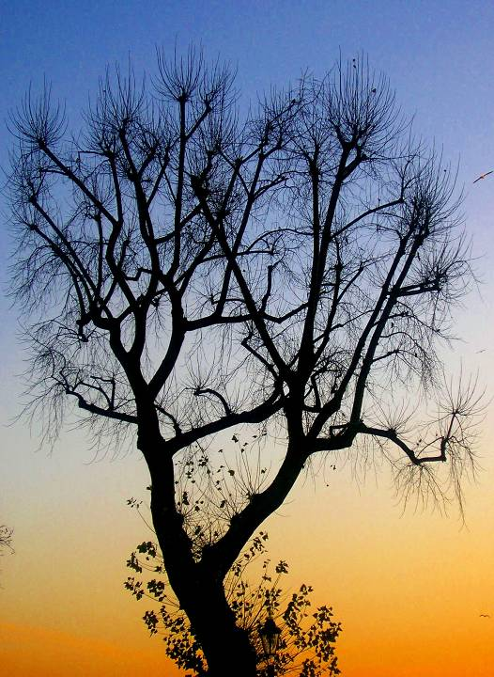
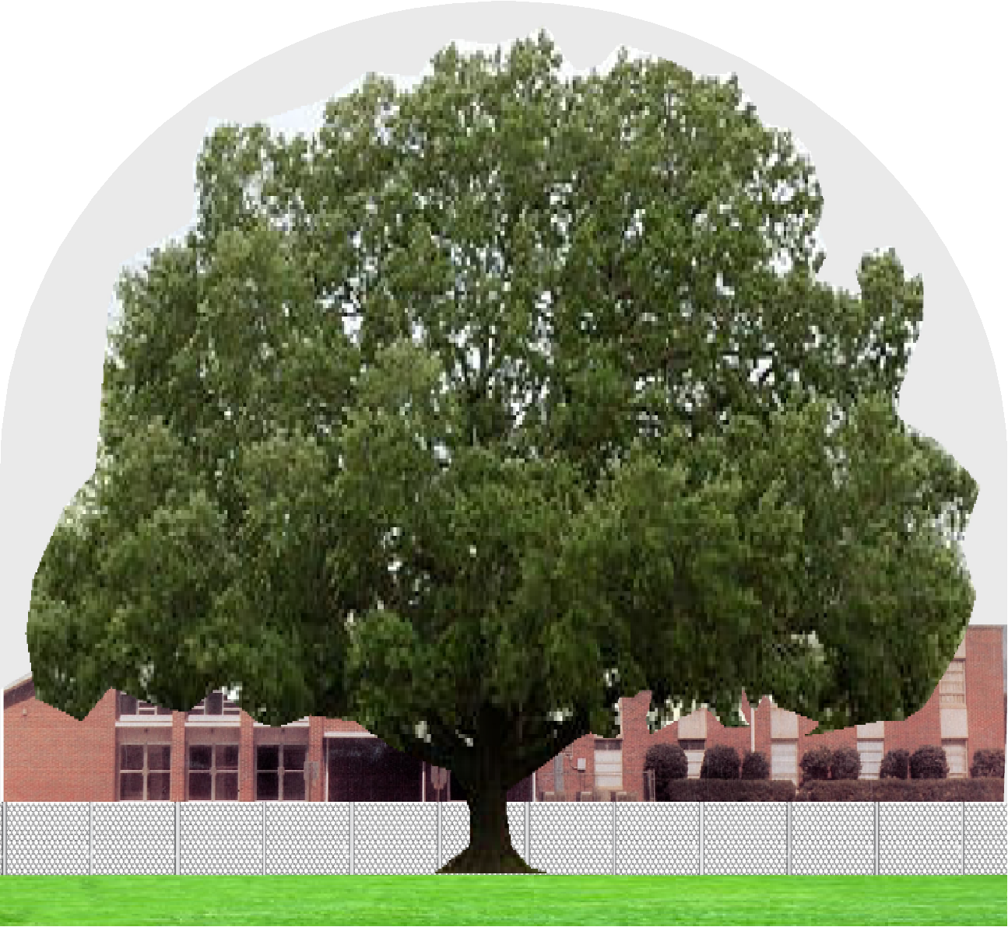
We must grow OUTWARD
Notes:
IV. The Christian must Grow OUTWARD.
A. Some of you may recognize this tree.
When you leave the building today, just look straight ahead and you
will see it.
I tell everyone back in Alabama that I have the biggest tree in
Georgia in my back yard.
I love to sit under it and listen to the wind whistle through the
leaves in the summertime.
You can sit out under it for 10 minutes after the rain starts and not
get wet.
B. A tree cannot grow unless it branches out.

Slide 24
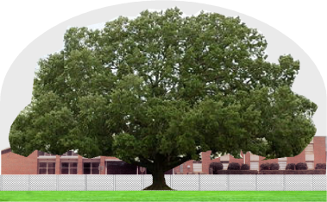
We must grow OUTWARD
We must branch out
Always abound in the work – 1 Cor. 15:58
Preach the gospel to all – 2 Tim. 2:2
Do good unto all – Gal. 6:10
Be an example to all – Matt. 5:16
Notes:
1. As Christians, We must branch out like the tree.
a. Always abounding in the work, as we have already read in –
1 Cor.15:58.
b. Preach the Gospel to all – 2 Tim.2:2. and what you have
heard from me in the presence of many witnesses entrust to
faithful men who will be able to teach others also.
c. Do good unto all – Gal.6:10. So then, as we have opportunity,
let us do good to everyone, and especially to those who are
of the household of faith.
d. Be an example to all – Matt.5:16. Let your light so shine
before men, that they may see your good works and glorify
your Father in heaven.

Slide 25
Psalms 1:3– “And he shall be like a tree planted by the streams of water, That bringeth forth its fruit in its season, Whose leaf also doth not wither; And whatsoever he doeth shall prosper.”
Notes:
Conclusion:
A. Can you say you are growing in all these directions?
B. Can you say you are like the tree planted by the rivers of waters?
1. Who brings forth his fruit in due season?
2. Whose leaf does not wither?
3. And who prospers in what you do?
C. For this to be true, you must grow downward, upward, inward and
outward.
1. This must be done steadily all at the same time.

Slide 26
ARE YOU A CHRISTIAN?
Hear – Rom.10:17
Faith – Jn.8:24
Repent – Acts 17:30
Confess – Rom. 10:9
Be Baptized – 1 Pet.3:21
ARE YOU FAITHFUL?
Confess sins – James 5:16
Live faithfully – Matt:10:22
Notes:
D. Are you doing these things as a christian?
E. If not, repent of your shortcomings and start today?
F. If you are not a Christian, plant yourself firmly in the Lord by obeying
the gospel today

