Slide 1
Putting Off The Old Man

Slide 2
Putting Off The Old Man

Slide 3
Putting Off The Old Man
Study Bible - learn more of God’s will
Yes, but help spiritually first / Love
Get out of sin / Repent / Obey Christ
Get priorities in order - God first!
More Faithful in attendance / godly association
Practice what is right
More joy in serving Christ
Take better care of my “temple”
Put away hinderances
Be filled with the Spirit

Slide 4
Putting Off The Old Man
Requires that we transform our thinking to harmonize with God’s will - Prov 23:7; Rom 12:1,2; Col. 3:1-3
Requires that we feed upon God’s word - Psalm 1:1,2; 1 Pet 2:2; 2 Tim 2:15
Requires that we understand & follow God’s word - Mat 7:21; 13:23; James 1:21-25

Slide 5
Philippians 3:12-16 (NKJV)
¹² Not that I have already attained, or am already perfected; but I press on, that I may lay hold of that for which Christ Jesus has also laid hold of me. ¹³ Brethren, I do not count myself to have apprehended; but one thing I do, forgetting those things which are behind and reaching forward to those things which are ahead, ¹⁴ I press toward the goal for the prize of the upward call of God in Christ Jesus. ¹⁵ Therefore let us, as many as are mature, have this mind; and if in anything you think otherwise, God will reveal even this to you. ¹⁶ Nevertheless, to the degree that we have already attained, let us walk by the same rule, let us be of the same mind.
Notes:
You Are Welcome At Any And All of Our Services!

Slide 6
Galatians 6:14-16 (NKJV)
¹⁴ But God forbid that I should boast except in the cross of our Lord Jesus Christ, by whom the world has been crucified to me, and I to the world. ¹⁵ For in Christ Jesus neither circumcision nor uncircumcision avails anything, but a new creation. ¹⁶ And as many as walk according to this rule, peace and mercy be upon them, and upon the Israel of God.
Notes:
You Are Welcome At Any And All of Our Services!

Slide 7
Romans 13:11-14 (NKJV)
¹¹ And do this, knowing the time, that now it is high time to awake out of sleep; for now our salvation is nearer than when we first believed. ¹² The night is far spent, the day is at hand. Therefore let us cast off the works of darkness, and let us put on the armor of light. ¹³ Let us walk properly, as in the day, not in revelry and drunkenness, not in lewdness and lust, not in strife and envy. ¹⁴ But put on the Lord Jesus Christ, and make no provision for the flesh, to fulfill its lusts.
Notes:
You Are Welcome At Any And All of Our Services!

Slide 8
Putting Off The Old Man
Futile in their Minds – 17
Understanding Darkened – 18
Alienated from Life – 18
Ignorant & Blind – 18
Past Feeling – 19
Serves Lewdness – 19
Works uncleanness - 19
With Greediness – 19
Grows Corrupt Because of Deceitful Lust - 22
25 Lying,
26 Vengeful & harbored anger,
27 Giving the devil a place.
28 Stealing
29 Corrupt words
30 Grieves the Holy Spirit of God,
31 Bitterness, wrath, anger, clamor, evil speaking and malice.

Slide 9
Putting ON The New Man
Futile in their Minds – 17
Understanding Darkened – 18
Alienated from Life – 18
Ignorant & Blind – 18
Past Feeling – 19
Serves Lewdness – 19
Works uncleanness - 19
With Greediness – 19
Grows Corrupt Because of Deceitful Lust - 22
25 Lying, 26 Vengeful & harbored anger, 27 Giving the devil a place. 28 Stealing 29 Corrupt words 30 Grieves the Holy Spirit of God, 31 Bitterness, wrath, anger, clamor, evil speaking and malice.

Slide 10
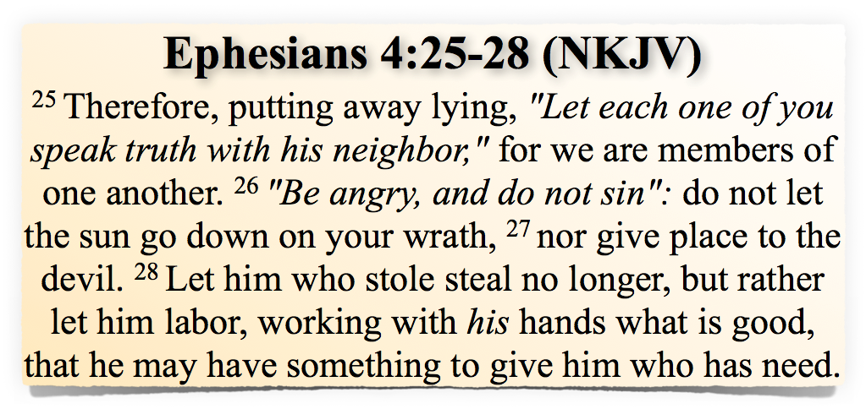
Putting ON The New Man
Futile in their Minds – 17
Understanding Darkened – 18
Alienated from Life – 18
Ignorant & Blind – 18
Past Feeling – 19
Serves Lewdness – 19
Works uncleanness - 19
With Greediness – 19
Grows Corrupt Because of Deceitful Lust - 22
25 Lying, 26 Vengeful & harbored anger, 27 Giving the devil a place. 28 Stealing 29 Corrupt words 30 Grieves the Holy Spirit of God, 31 Bitterness, wrath, anger, clamor, evil speaking and malice.

Slide 11
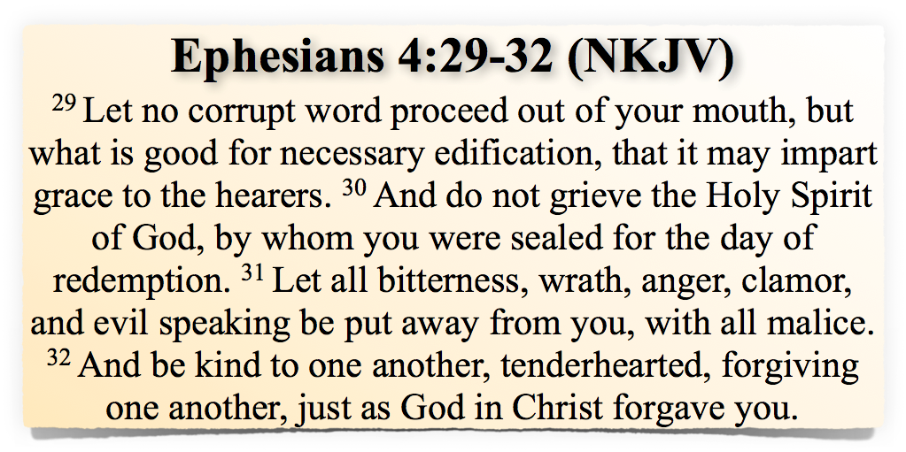
Putting ON The New Man
Futile in their Minds – 17
Understanding Darkened – 18
Alienated from Life – 18
Ignorant & Blind – 18
Past Feeling – 19
Serves Lewdness – 19
Works uncleanness - 19
With Greediness – 19
Grows Corrupt Because of Deceitful Lust - 22
25 Lying, 26 Vengeful & harbored anger, 27 Giving the devil a place. 28 Stealing 29 Corrupt words 30 Grieves the Holy Spirit of God, 31 Bitterness, wrath, anger, clamor, evil speaking and malice.

Slide 12
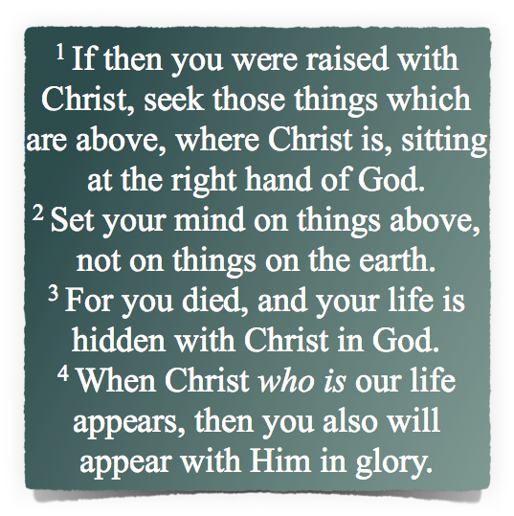
Putting Off The Old Man
Fornication (v. 5)
Uncleanness (v. 5)
Passion (v. 5)
Evil Desire (v. 5)
Covetousness - Idolatry (v. 5)
Anger (v. 8)
Wrath (v. 8)
Malice (v. 8)
Blasphemy (v. 8)
Filthy Language (v. 8)
Lying (v. 9)

Slide 13
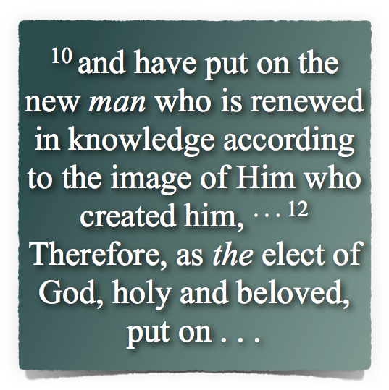
Putting ON The New Man
12 Mercy, kindness, humility, meekness, longsuffering;
13 bearing with one another, and forgiving one another, . . .
14 . . . most importantly - love,
15 let the peace of God rule in your hearts, . . . be thankful.
16 worship, admonish one another . . .
17 Submitting to Christ’s authority in everything

Slide 14
Putting Off The Old Man
Requires that we transform our thinking to harmonize with God’s will - Prov 23:7; Rom 12:1,2; Col. 3:1-3
Requires that we feed upon God’s word - Psalm 1:1,2; 1 Pet 2:2; 2 Tim 2:15
Requires that we understand & follow God’s word - Mat 7:21; 13:23; James 1:21-25

Slide 15
Putting Off The Old Man
Repent & seek God’s forgiveness & “No longer be a slave to sin”
Seek forgiveness from those you have hurt and “as far as it depends on you, live at peace with all”
Forgive yourself and “move on from the past”
Forgive those who have hurt you and ask for your forgiveness - “forgive whatever grievances you have”
Commit to being faithful to God!

Slide 16
Putting Off The Old Man
Have you heard the true gospel of Christ? - John 8:32; Rom 10:17
Do you believe that Jesus is the Christ, the Son of God? - John 8:24; Rom 10:9,10
Repent of your sins! - Luke 13:3,5; Acts 2:38
Confess Christ - Rom 10:9,10
Be baptized - Acts 2:38; Gal 3:26,27; Rom 3:3-6
Live for Christ who died for you - 2 Cor 5:14-17; 1 Cor 15:58

Slide 17
17
Don McClain
W 65th St church of Christ / November 25, 2007

Slide 18
Putting Off The Old Man
Charts by Don McClain
Prepared January 2-4, 2014
Preached January 5, 2014
West 65th Street church of Christ
P.O. Box 190062
Little Rock AR 72219
501-568-1062
Prepared using Keynote
Email – donmcclain@sbcglobal.net
More Keynote, PPT & Audio Sermons:
http://w65stchurchofchrist.org/coc/sermons/
Note – Many of the transition effects used in this presentation will be lost using PPT 2007 Viewer
http://www.microsoft.com/downloads/details.aspx?FamilyID=cb9bf144-1076-4615-9951-294eeb832823&displaylang=en

Slide 19
Ephesians 4:17-24 (NKJV)
¹⁷ This I say, therefore, and testify in the Lord, that you should no longer walk as the rest of the Gentiles walk, in the futility of their mind, ¹⁸ having their understanding darkened, being alienated from the life of God, because of the ignorance that is in them, because of the blindness of their heart; ¹⁹ who, being past feeling, have given themselves over to lewdness, to work all uncleanness with greediness.
Notes:
You Are Welcome At Any And All of Our Services!

Slide 20
Ephesians 4:17-24 (NKJV)
²⁰ But you have not so learned Christ, ²¹ if indeed you have heard Him and have been taught by Him, as the truth is in Jesus: ²² that you put off, concerning your former conduct, the old man which grows corrupt according to the deceitful lusts, ²³ and be renewed in the spirit of your mind, ²⁴ and that you put on the new man which was created according to God, in true righteousness and holiness.
Notes:
You Are Welcome At Any And All of Our Services!

