Slide 1


Church Announcements
November 1st, 2023

Slide 2

Sympathy
Our sympathy goes out to the family of Adrian Autry
He is a family member to Sister Dureen Fuller

Slide 3
Sympathy
Our sympathy goes out to the family of Lenolia Minter
She is the Aunt of Sister Betsy Jones

Slide 4
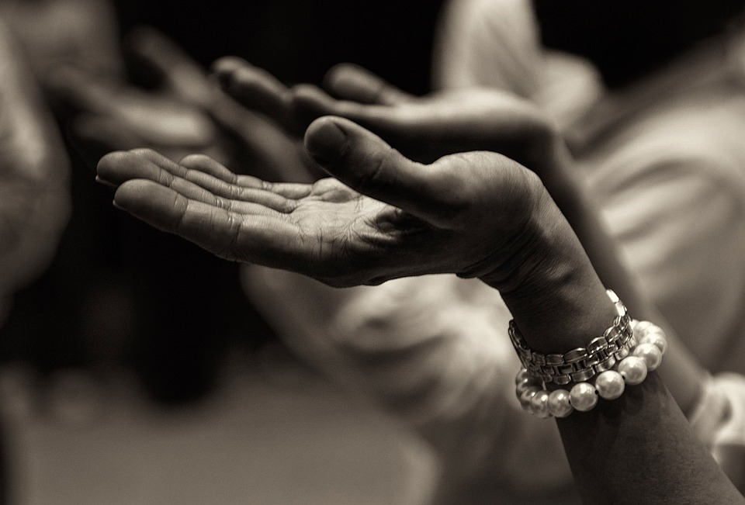
Prayer List
Geraldine Bolden
Clarence Brooks
John Brooks
Patricia Brooks
Dalton Carpenter
Adrean Chism
Jacory Chism
Faye Davis
Shronda Davis
Helen Evans
Tony & Ta’Riyah Fleming
Richard & Darlene Fountain
Maryian Grant
Troyce Grant
Ella Hurdley
Jesse James Jr.
Kathy Malone
Wade Miller

Slide 5
Prayer List
Lillie Luster
Christina Matson
Wade Miller
Danielle Minter
David Minter
Waylon Minter
Jackie Mosley
Robert Nance Family
Linda Rhymes
Rose Rogers
Appezene Smith
Jeri Lyn Teague
John & Karen Vinyard
Mandy Rae Waters
Travis Wilson
Darlene Woodson
Randy Woodson

Slide 6
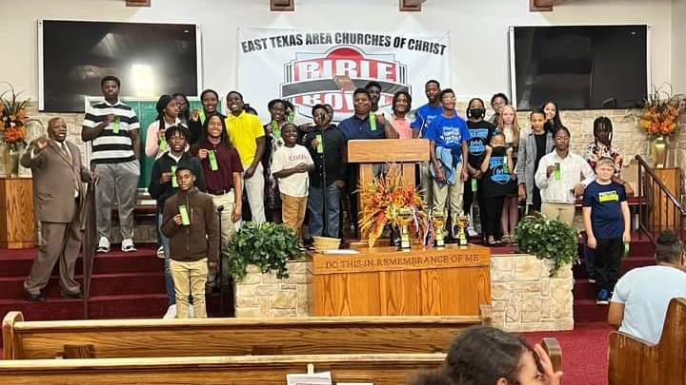
Congratulations to our youth group for winning Bible Bowl

Slide 7
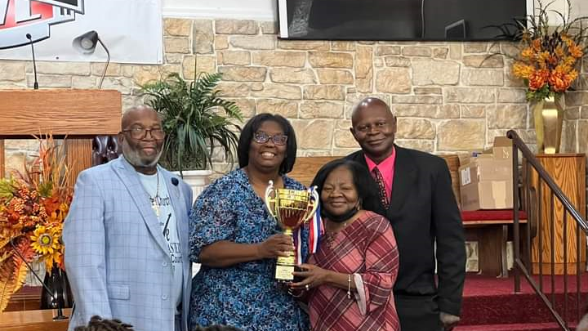
Thanks to Sister Sherry Luster, Sister Joyce Talbert, & all others for all their hard work and time spent with our youth group.

Slide 8

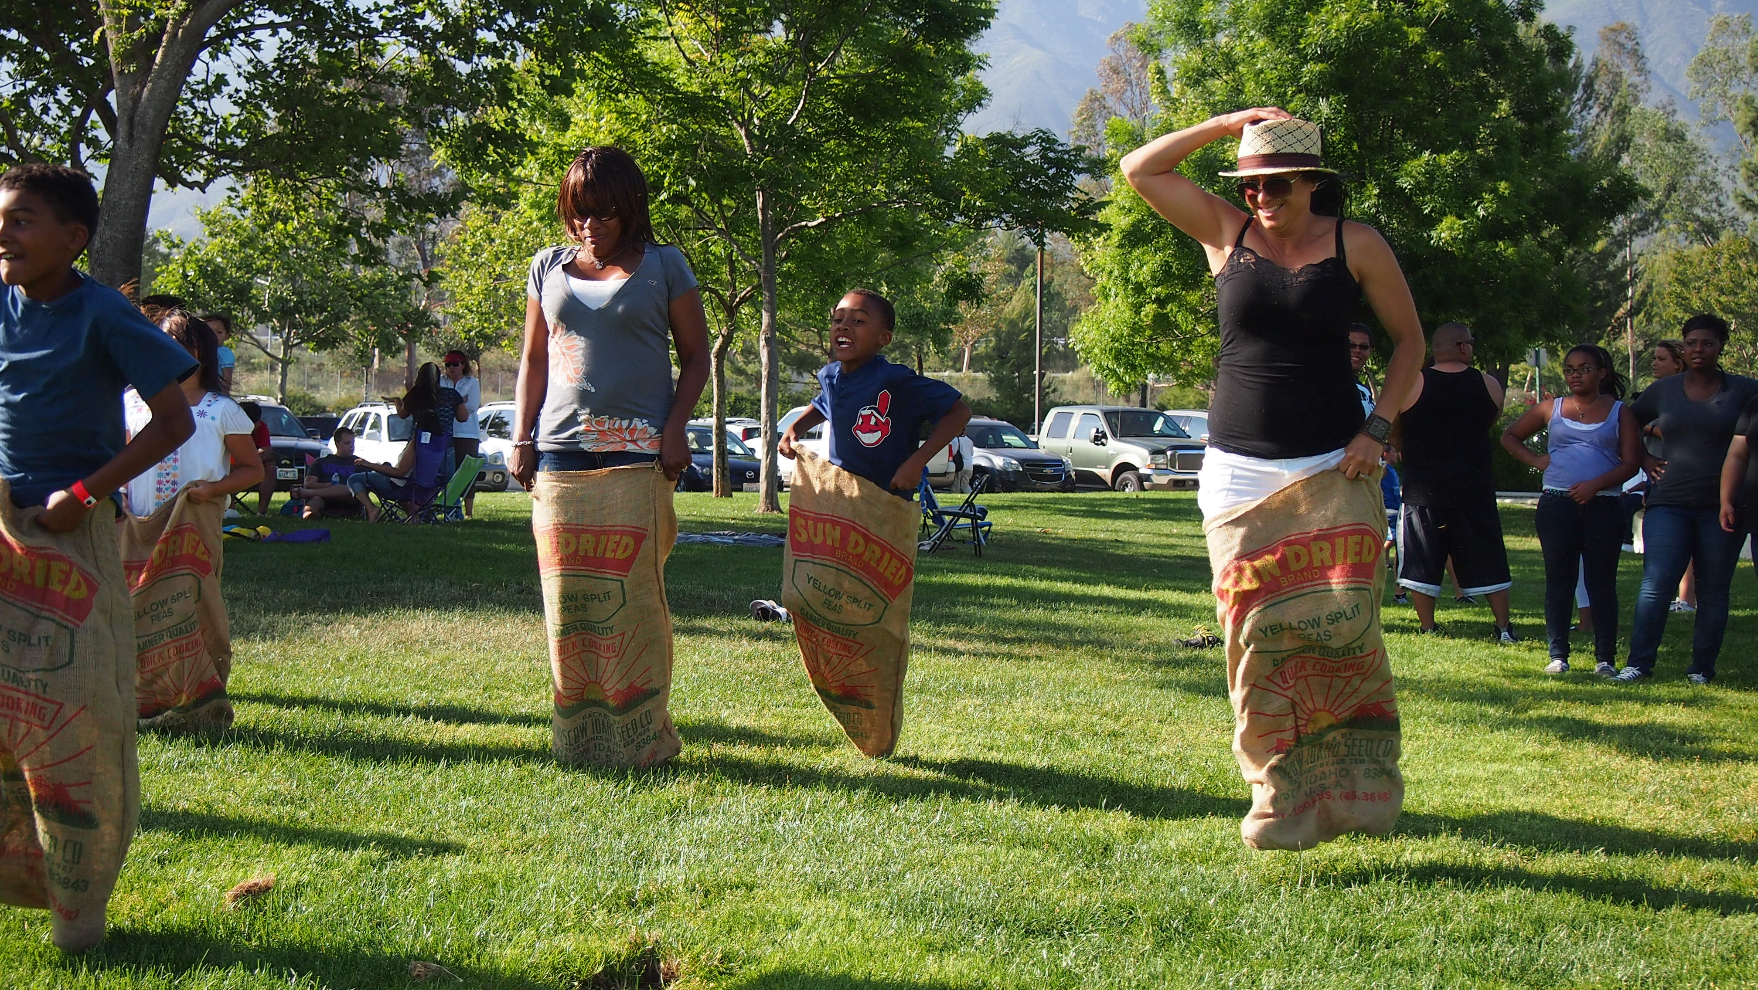
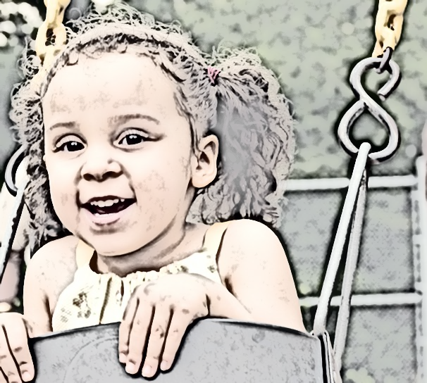
Fall Fun Day Nov. 04,2023 1pm-6pm
Hosted by NAACP

Slide 9
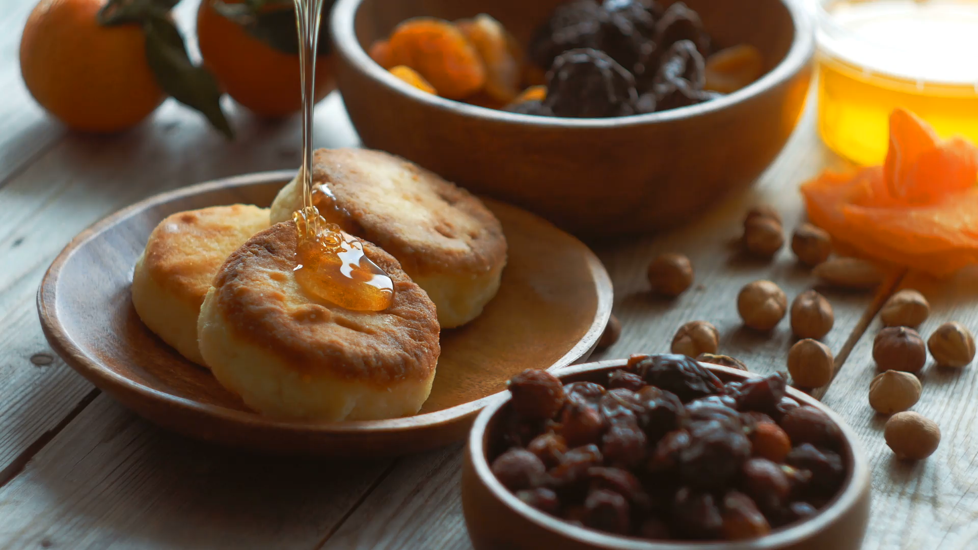
Sunday school breakfast will be provided on Nov. 5th,2023 from 9am-9:30am.

Slide 10
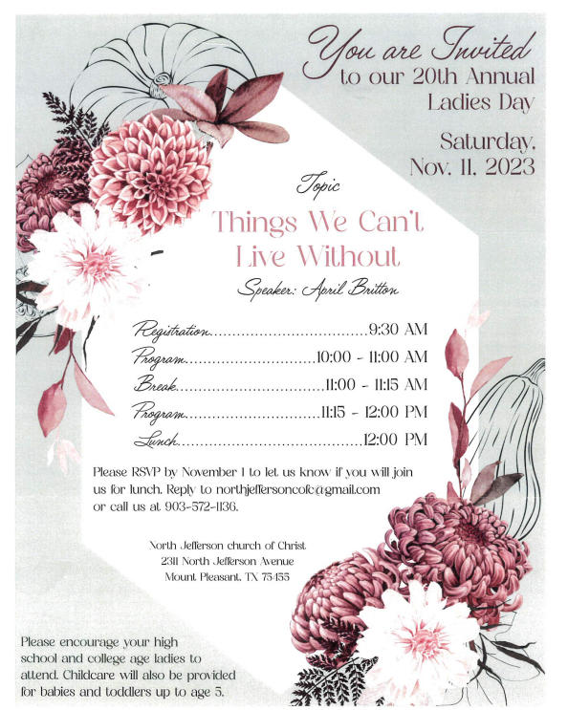

Slide 11
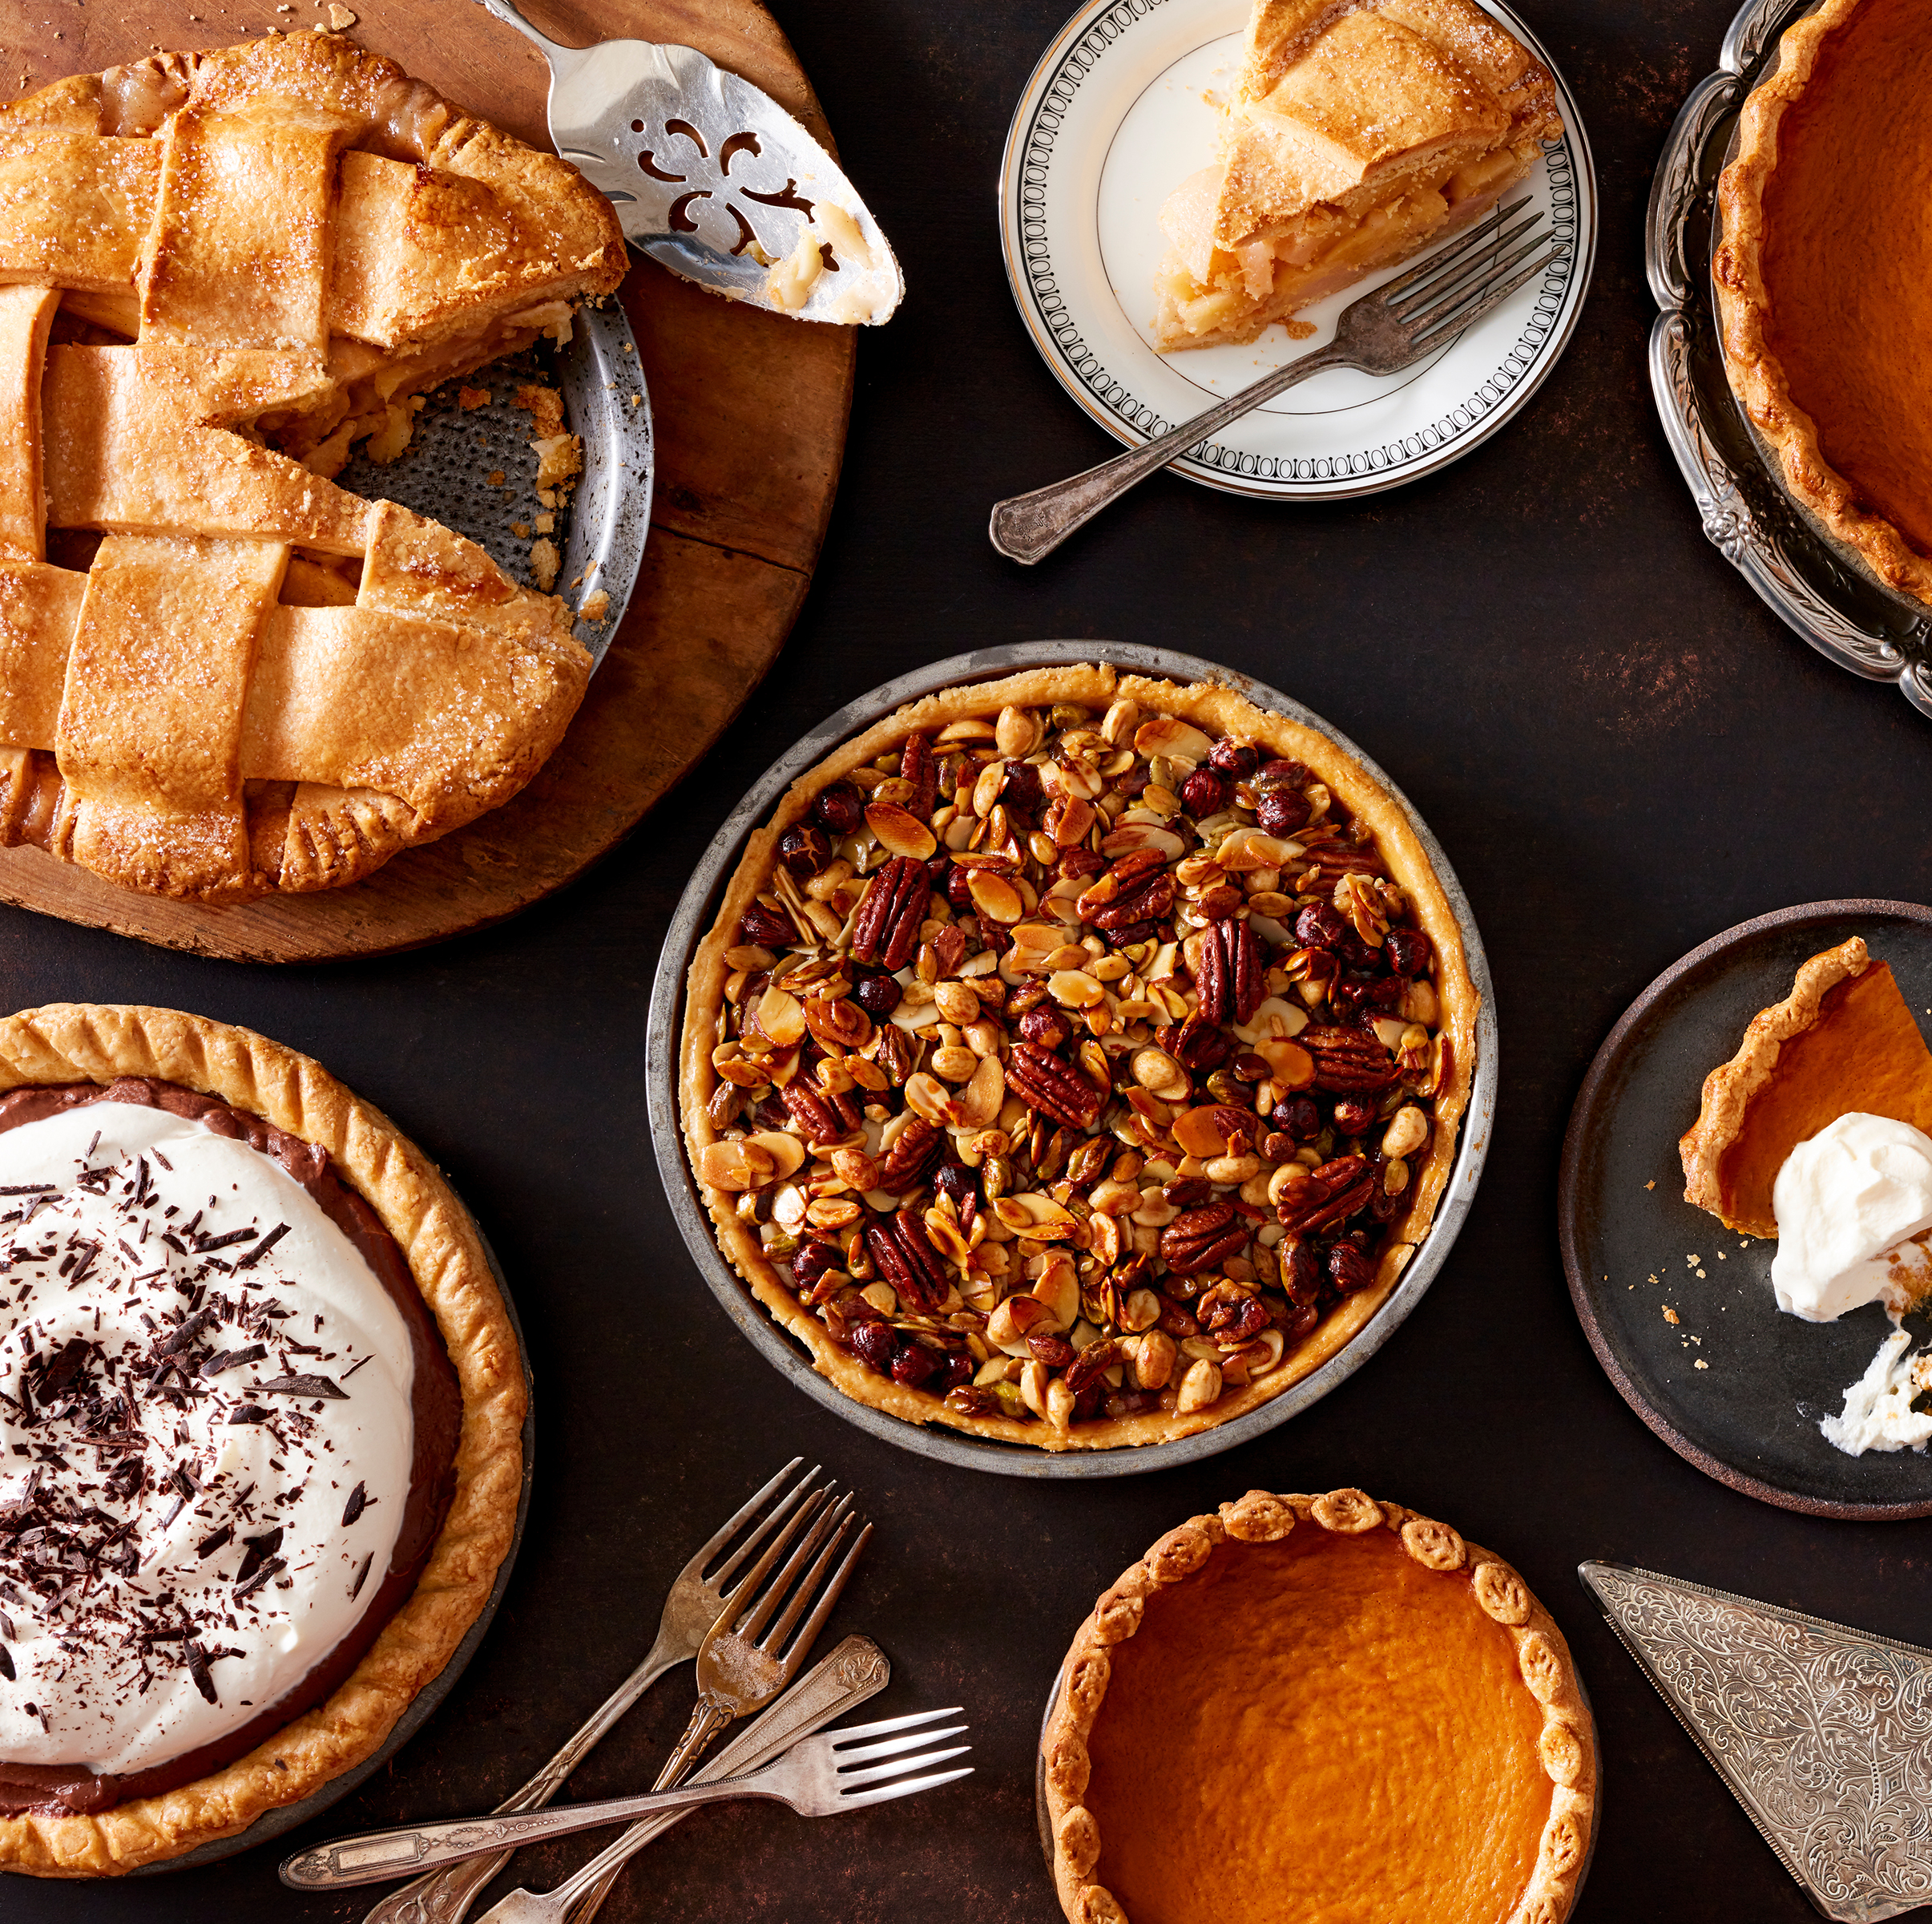
Salad & Dessert Sign up
Please make sure to sign up in
foyer if you plan on bringing a
cake or salad for gospel
meeting
lunch on November 12th

Slide 12


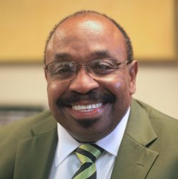
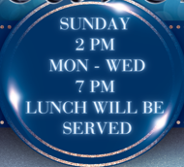
Sheppard St. Gospel Meeting
Nov. 12th–15th
Guest Speaker Brother Billy Moore

Slide 13

Our brother's business meeting will be Saturday November 18th 10am

Slide 14
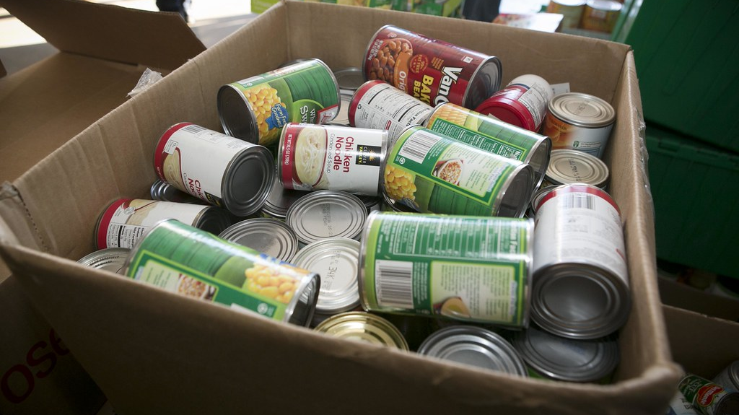
Sheppard St. Pantry will be open Sundays after Sunday Worship Class and on Tuesdays from 10am-12pm.

Slide 15
Church Announcements
November 1st, 2023

Slide 16
Sympathy
Our sympathy goes out to the family of Adrian Autry
He is a family member to Sister Dureen Fuller

Slide 17
Sympathy
Our sympathy goes out to the family of Lenolia Minter
She is the Aunt of Sister Betsy Jones

Slide 18
Prayer List
Geraldine Bolden
Clarence Brooks
John Brooks
Patricia Brooks
Dalton Carpenter
Adrean Chism
Jacory Chism
Faye Davis
Shronda Davis
Helen Evans
Tony & Ta’Riyah Fleming
Richard & Darlene Fountain
Maryian Grant
Troyce Grant
Ella Hurdley
Jesse James Jr.
Kathy Malone
Wade Miller

Slide 19
Prayer List
Lillie Luster
Christina Matson
Wade Miller
Danielle Minter
David Minter
Waylon Minter
Jackie Mosley
Robert Nance Family
Linda Rhymes
Rose Rogers
Appezene Smith
Jeri Lyn Teague
John & Karen Vinyard
Mandy Rae Waters
Travis Wilson
Darlene Woodson
Randy Woodson

Slide 20
Congratulations to our youth group for winning Bible Bowl

Slide 21
Thanks to Sister Sherry Luster, Sister Joyce Talbert, & all others for all their hard work and time spent with our youth group.

Slide 22
Fall Fun Day Nov. 04,2023 1pm-6pm
Hosted by NAACP

Slide 23
Sunday school breakfast will be provided on Nov. 5th,2023 from 9am-9:30am.

Slide 25
Salad & Dessert Sign up
Please make sure to sign up in
foyer if you plan on bringing a
cake or salad for gospel
meeting
lunch on November 12th

Slide 26
Sheppard St. Gospel Meeting
Nov. 12th–15th
Guest Speaker Brother Billy Moore

Slide 27
Our brother's business meeting will be Saturday November 18th 10am

Slide 28
Sheppard St. Pantry will be open Sundays after Sunday Worship Class and on Tuesdays from 10am-12pm.

Slide 29


Church Announcements
November 1st, 2023

Slide 30
Church Announcements
November 1st, 2023

Slide 31
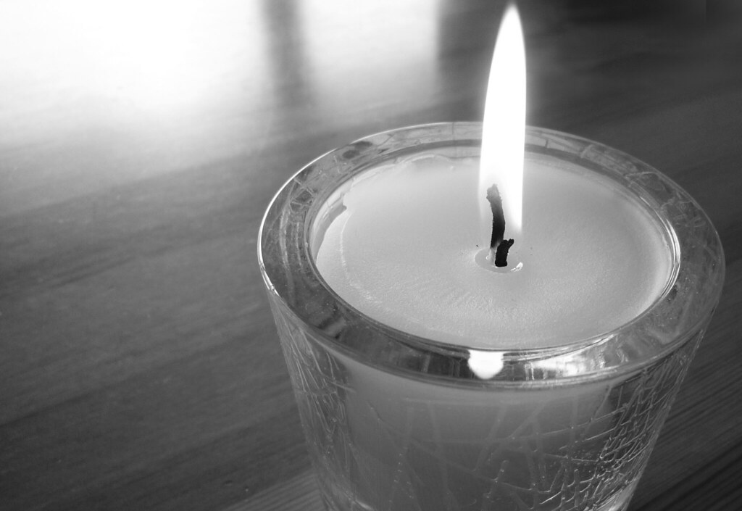
Sympathy
Our sympathy goes out to the family of Lenolia Minter
She is a family member to Sister Betsy Jones

Slide 32
Sympathy
Our sympathy goes out to the family of Lenolia Minter
She is a family member to Sister Betsy Jones

Slide 33
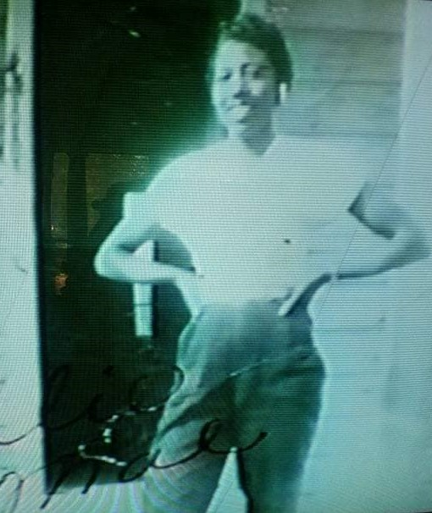
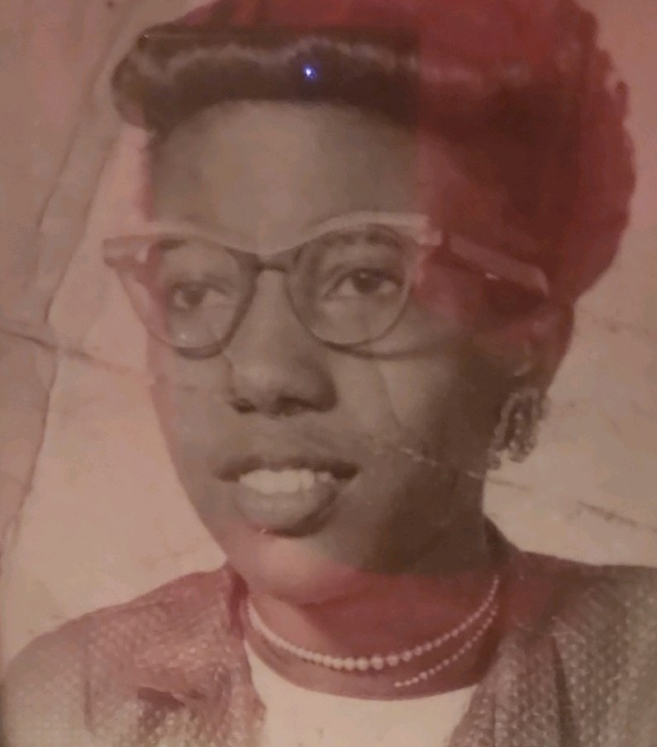
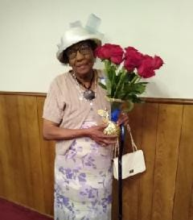
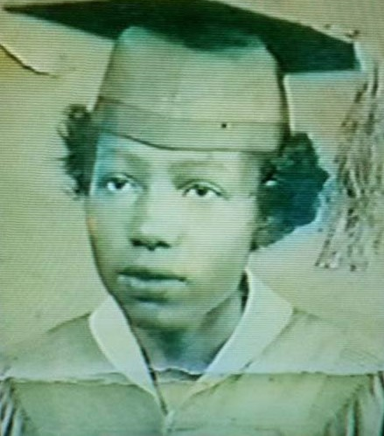
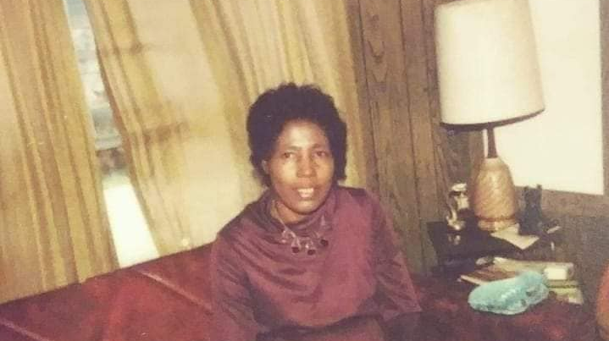
Honoring our Oldest Female Member
Sister Ollie Mae Eaton
Born 06-16-1931
She is 92 blessed yrs. old

Slide 34
Sympathy
Our sympathy goes out to the family of Adrian Autry
He is a family member to Sister Dureen Fuller

Slide 35
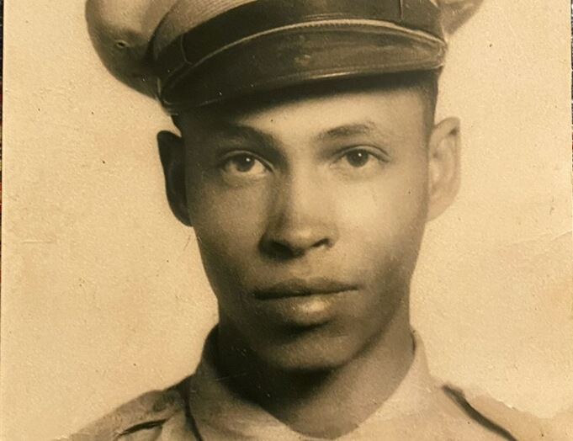
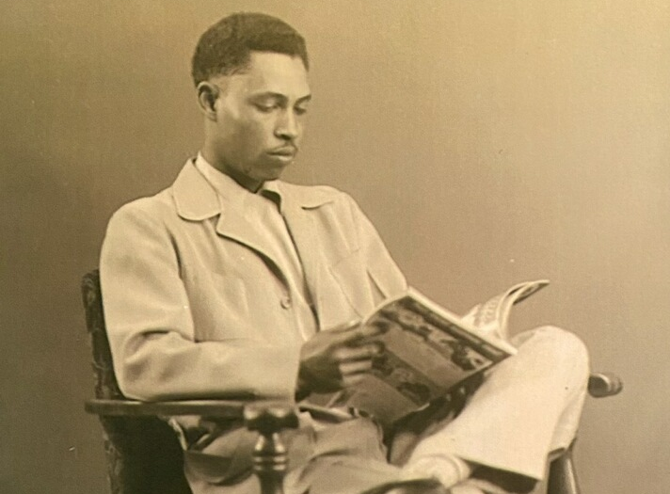
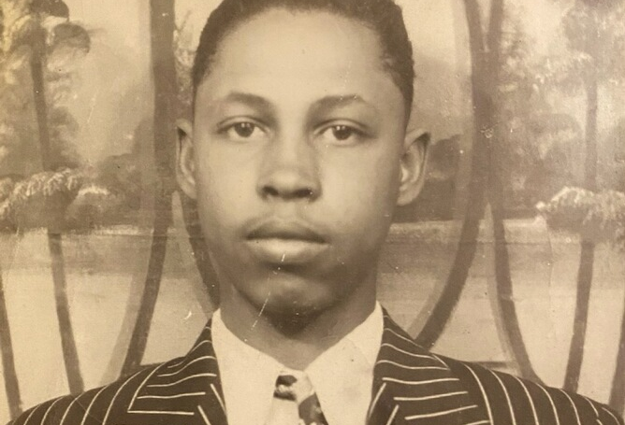
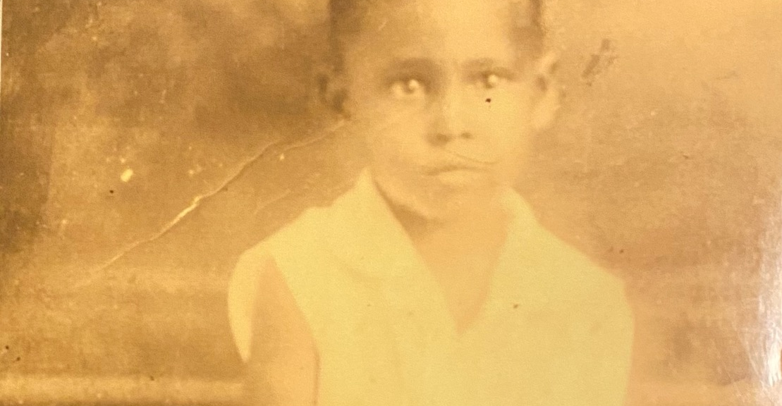
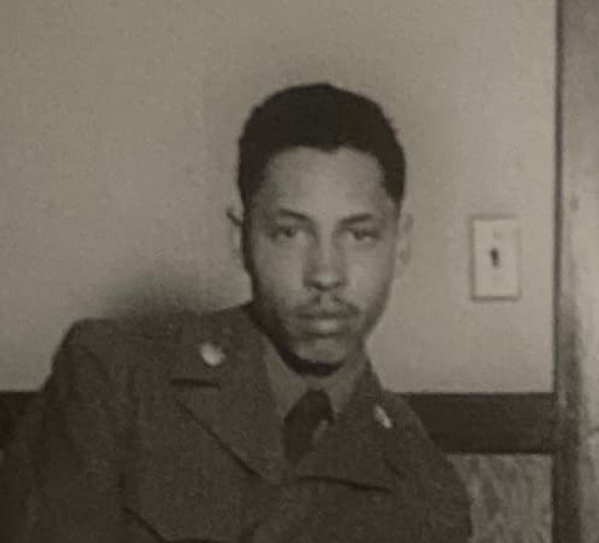
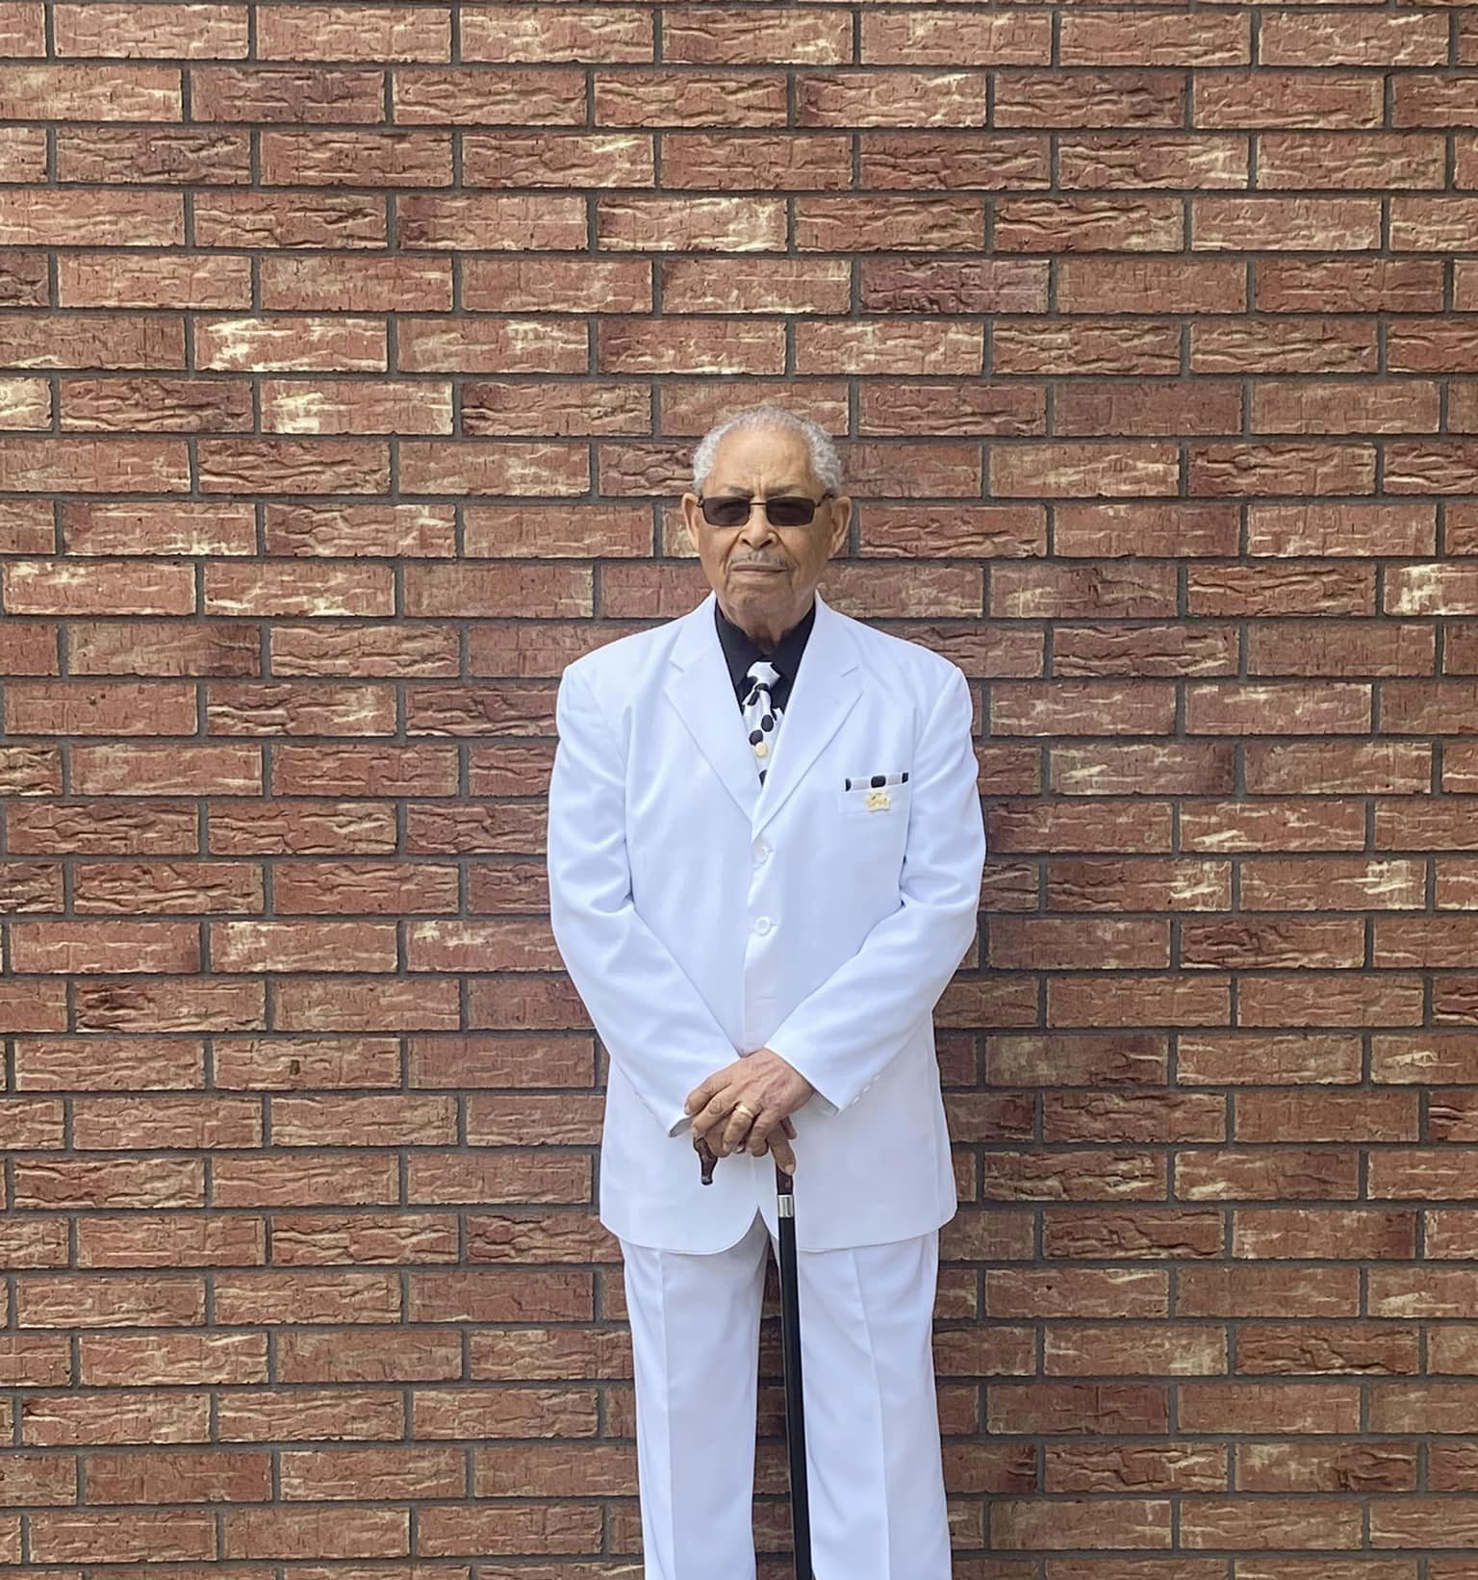
Honoring our Oldest Male Member
Brother Florence Brannon
Born 05-02-1930
He is 93 blessed yrs. old

Slide 36
Sympathy
Our sympathy goes out to the family of Adrian Autry
He is a family member to Sister Dureen Fuller

Slide 37
Sheppard St. Pantry will be open CLOSED until September

Slide 38
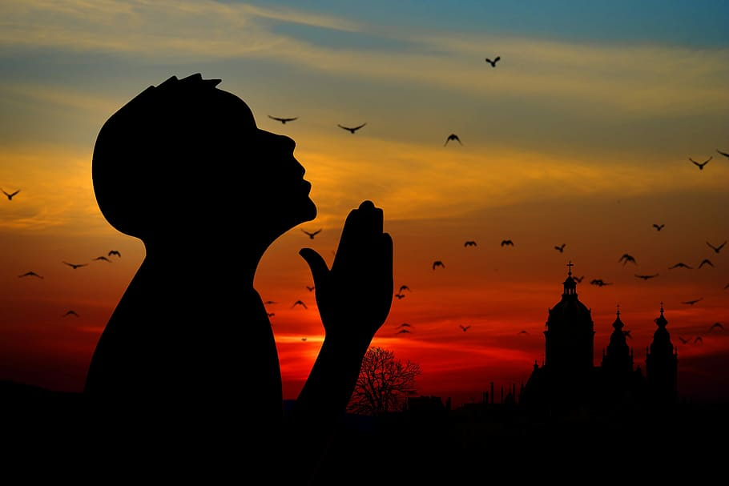
Prayer List
Sharon Allen
Michelle Brad
Jamarion Brown
Zay Brown
Khaily Bryson
Dalton Carpenter
Adrean Chism
Gladys Chism
Jacory Chism
Yvonne Craddock
Faye Davis
Shronda Davis
Helen Evans
Richard & Darlene Fountain
Earnest & Dureen Fuller (Traveling)

Slide 39
Prayer List
Maryian Grant
Troyce Grant
Ella Hurdley
Eric Linwood
Christina Matson
Lenolia Minter
Wade Miller
Waylon Minter
Linda Rhymes
Rose Rogers
Appezene Smith
Talbert Family(Traveling)
Jeri Lyn Teague
Jonathan Turner
Mandy Rae Waters
Travis Wilson

Slide 40
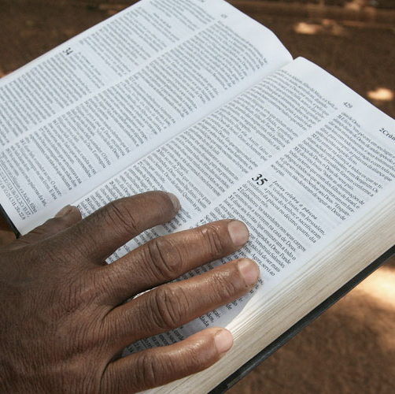
Family Bible Bowl of Northeast TX. Test
North Jefferson Church of Christ Church
Date: October 9th,2023 at 7pm.
Topic: Romans 1-2:24
This Photo by Unknown Author is licensed under CC BY-SA-NC

Slide 41
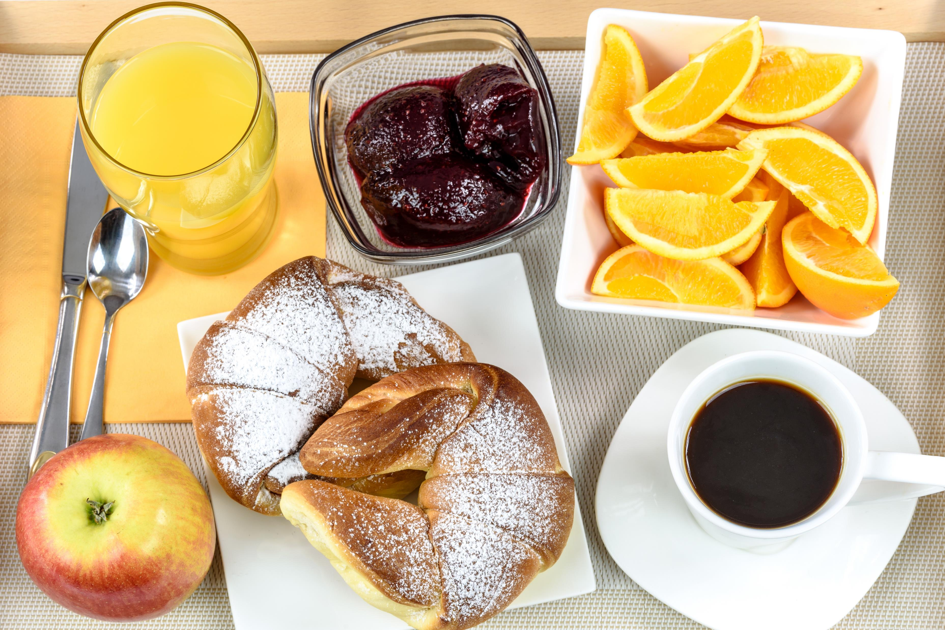
Breakfast will be served the 1st of each month before Sunday school.
The next breakfast will be served October 01,2023.

Slide 42
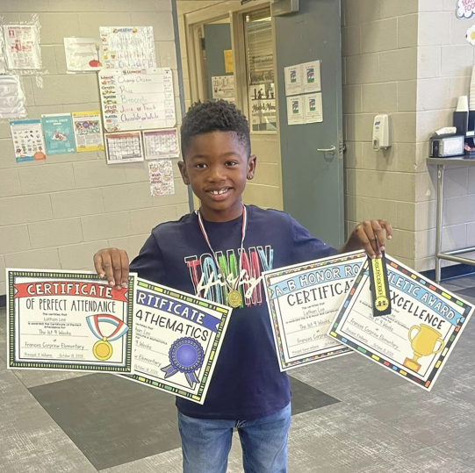
Congratulations Lathan!!
For receiving awards
A/B Honor Roll
Math Award
Perfect Attendance
PE Award

Slide 43
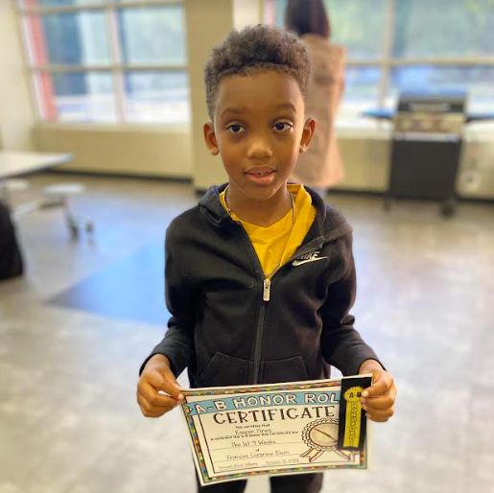
Congratulations Kasper!!
For making the A & B Honor Roll

